Slide 1

Stop the Spread
Firestopping from design to specification

Slide 2
Objectives
Recognize conditions where firestopping is required by the building code.
Interpret building code requirements applicable to firestopping.
Identify the locations where firestopping requirements should be located/found in the contract documents.
Interpret the contract documents to determine the scope of firestopping.
Describe the benefits of requiring experienced firestopping installers on a project.

Slide 3
Building Code Requirements
Where it all begins

Slide 4
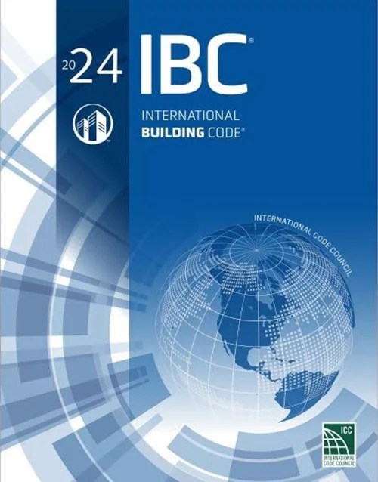
Fire-Resistive Assemblies
There are five different fire-resistive assemblies:
  Fire walls 2 to 4 hours
  Fire barriers 1 to 4 hours
  Fire partitions 1 hour
  Smoke barriers 1 hour
    Smoke partitions 0 hours
  Horizontal assemblies 1 to 3 hours
Fire-resistance-rated walls, ceilings, or roofs that have protected openings to restrict the spread of fire

Slide 5
Fire-Resistive Construction
There are two types of fire-resistive construction:
  Exterior walls
    Openings are only required to be protected if a wall is required to be fire-resistance-rated and openings exceed the allowable area for unprotected openings
    Openings include joints and penetrations
  Interior bearing walls
    Openings, including joints and penetrations, are not required to be protected
Fire-resistance-rated walls, ceilings, or roofs that are required to be protected per IBC Tables 601 and 705.5

Slide 6
IBC Section 714 – Penetrations
Two Main Locations for Requirements:
  Section 714.4 – Requirements for fire-resistance-rated walls
  Section 714.5 – Requirements for horizontal assemblies
Two Options:
  Use assemblies as tested per ASTM E814 or UL 1479
    Walls: F-rating equal to or greater than the fire-resistance rating of the wall assembly
      Membrane Penetrations other than Electrical Boxes: F- and T-ratings ≥ rating of wall
    Horizontal Assemblies: F- and T-ratings not less than one hour, but not less than the rating of the floor
  Use assemblies as tested in the approved fire-resistance-rated assembly

Slide 7
IBC Section 714 – Penetrations
Two Main Locations for Requirements:
  Section 714.4 – Requirements for fire-resistance-rated walls
  Section 714.5 – Requirements for horizontal assemblies
Two Options:
  Use assemblies as tested per ASTM E814 or UL 1479
    Walls: F-rating equal to or greater than the fire-resistance rating of the wall assembly
      Membrane Penetrations other than Electrical Boxes: F- and T-ratings ≥ rating of wall
    Horizontal Assemblies: F- and T-ratings not less than one hour, but not less than the rating of the floor
  Use assemblies as tested in the approved fire-resistance-rated assembly
“Standard Test Method For Fire Tests Of Penetration Firestop Systems”

Slide 8
IBC Section 714 – Penetrations
Two Main Locations for Requirements:
  Section 714.4 – Requirements for fire-resistance-rated walls
  Section 714.5 – Requirements for horizontal assemblies
Two Options:
  Use assemblies as tested per ASTM E814 or UL 1479
    Walls: F-rating equal to or greater than the fire-resistance rating of the wall assembly
      Membrane Penetrations other than Electrical Boxes: F- and T-ratings ≥ rating of wall
    Horizontal Assemblies: F- and T-ratings not less than one hour, but not less than the rating of the floor
  Use assemblies as tested in the approved fire-resistance-rated assembly
“Standard For Fire Tests Of Penetration Firestops”

Slide 9
IBC Section 714 – Penetrations
Smoke Barriers (§ 714.5.4):
  Firestop systems tested for air leakage per UL 1479
  L-Rating: Comply with one of the following…
    5.0 cfm per square foot of penetration opening for each through-penetration firestop system
    Total cumulative leakage of 50 cfm for any 100 square feet of wall or floor area.

Slide 10
IBC Section 714 – Penetrations
Non-Fire-Resistance Rated Floor & Floor/Ceilings (§ 714.6):
  Noncombustible Penetrating Items:
    Connect not more than 5 stories
    Annular space filled to resist the free passage of flame and products of combustion with:
      An approved noncombustible material; or,
      A tested through-penetration firestop system
  Any Penetrating Items:
    Connect not more than 2 stories
    Annular space filled with an approved material to resist the free passage of flame and products of combustion

Slide 11
IBC Section 715 – Joints and Voids
Section 715.3 – Fire-Resistance-Rated Assembly Intersections
  Applies to joints in or between fire-resistance-rated walls, floors or floor/ceiling assemblies, and roofs or roof/ceiling assemblies
  Protected by an approved fire-resistant joint system
  Firestop rating must be equal to or greater than the rating of the fire-resistance-rated assemblies

Slide 12
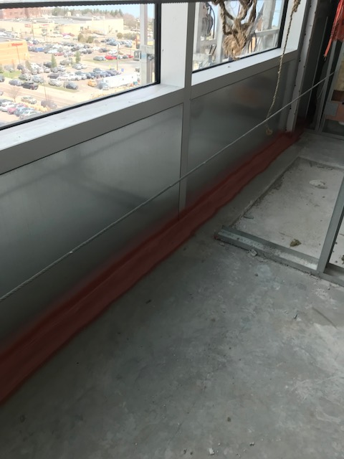
IBC Section 715 – Joints and Voids
Section 715.4 – Exterior Curtain Wall/Fire-Resistance-Rated Floor Intersections
  Protected by an approved perimeter fire containment system per ASTM E2307 “Standard Test Method For Determining Fire Resistance Of Perimeter Fire Barriers Using Intermediate-Scale, Multi-Story Test Apparatus”
  F-rating equal to or greater than the floor or floor/ceiling assembly

Slide 13
IBC Section 715 – Joints and Voids
Voids at the intersection of exterior curtain wall assemblies and the following are required to be filled with an approved material or system to retard the interior spread of fire and hot gases:
  Nonfire-resistance-rated floor or floor/ceiling assemblies (§ 715.5)
  Fire barriers and nonfire-resistance-rated roofs (§ 715.6)
Joints in smoke barriers must use systems with L-ratings of not more than 5 cfm/ft. at 0.30 inches water per UL 2079
Notes:
0.30 inches of water is equal to about 1/100th of a psi

Slide 14
IBC Section 717 – Ducts and Air Transfer Openings
Section 717.1.2 – Ducts that Penetrate Fire-Resistance-Rated Assemblies Without Dampers
  Walls: Comply with Sections 714.3 through 714.4.3 for through- and membrane-penetrations
  Horizontal Assemblies: When not enclosed in a shaft, comply with Sections 714.5 through 714.6.2 for through- and membrane-penetrations
    Nonfire-Resistance-Rated Floor Assemblies:
      Combustible Floors: Connect not more than two stories with annular space filled
      Noncombustible Floors: Connect not more than three stories with annular space filled

Slide 15
IBC Section 1705 – Required Special Inspections and Tests
Section 1705.18 – Fire-Resistant Penetrations and Joints
  Applicable to the following types of buildings:
    High-rise buildings
    Buildings in Risk Categories III and IV
    Group R occupancies with occupant loads > 250
  Special inspections must be conducted by an approved agency in accordance with the following:
    Penetration Firestops: Per ASTM E2174 “Standard Practice For On-Site Inspection Of Installed Firestops”
    Fire-Resistant Joint Systems: Per ASTM E2393 “Standard Practice For On-Site Inspection Of Installed Fire Resistive Joint Systems And Perimeter Fire Barriers”
Notes:
IBC Table 1604.5 lists the conditions for Risk Categories III and IV

Slide 16
Selecting Firestop Assemblies
Things you need to know before selecting a firestop system:
  What is the type of fire-resistance-rated assembly?
  What is the fire-resistance rating of the assembly?
    What is the required F-rating (for walls and horizontal assemblies)?
    What is the required T-rating (for horizontal assemblies and membrane penetrations)?
  Is an L-rating required (for smoke barriers)?
  What is the penetrating item or items?
NOTE: Refer to Chapter 2 of the FCIA Firestop Manual of Practice for a detailed discussion.

Slide 17
Selecting Firestop Assemblies (cont.)
Things you need to know before selecting a firestop system:
  What is the opening size?
  What is the opening shape?
  What is the maximum width for joints, perimeter fire containment, and other gaps?
  What is the construction of the fire-resistance-rated assembly?
  What is the thickness of the fire-resistance-rated assembly?
NOTE: Refer to Chapter 2 of the FCIA Firestop Manual of Practice for a detailed discussion.

Slide 18
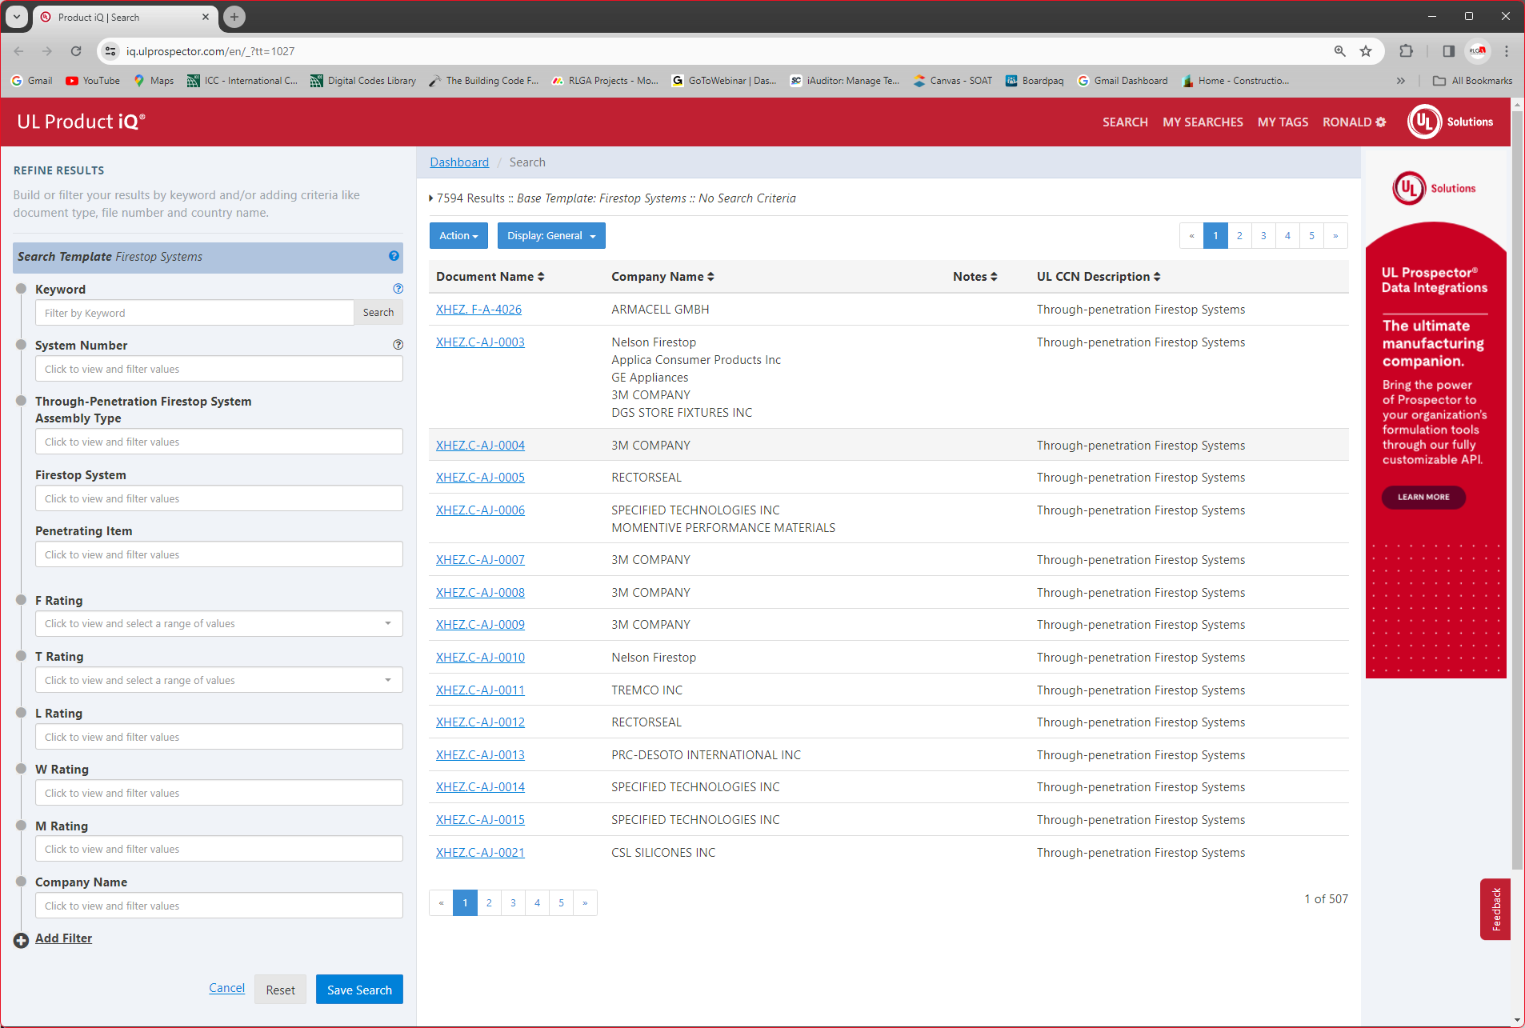
UL Product iQ:
UL Firestop System Listing Search

Slide 19
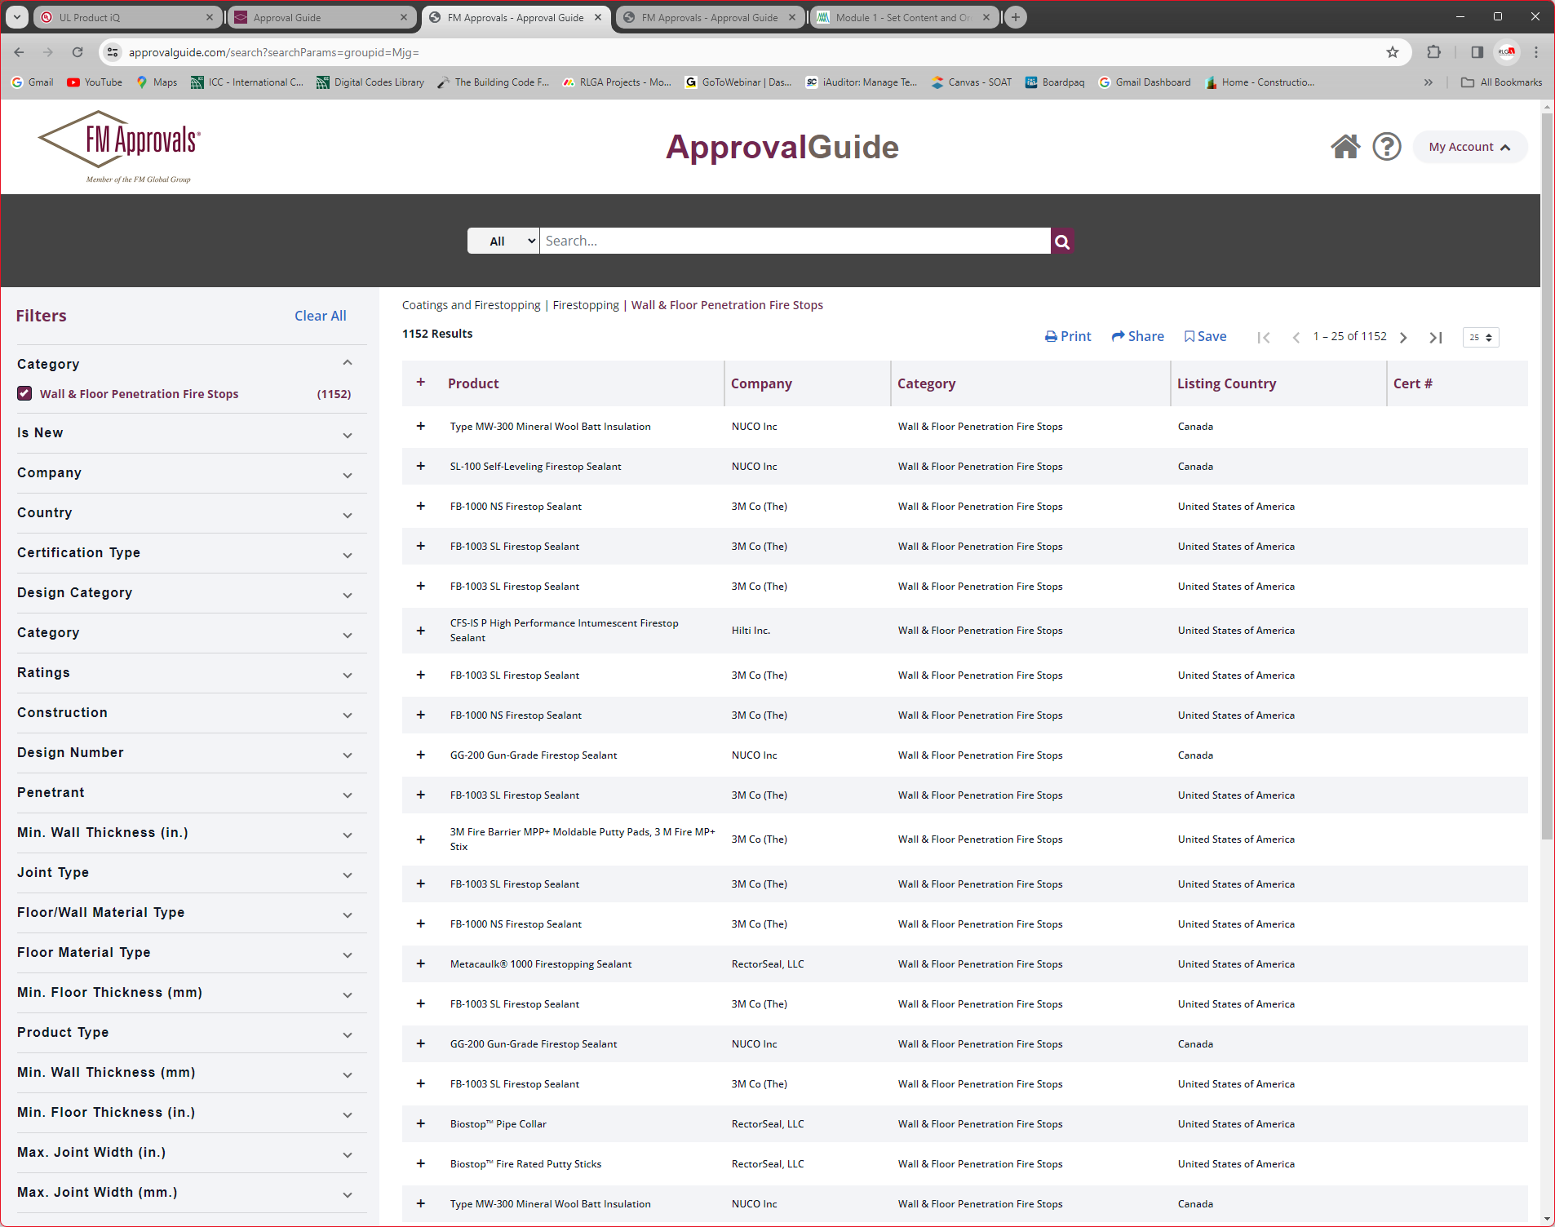
FM Approval Guide:
FM Firestop System Listing Search

Slide 20
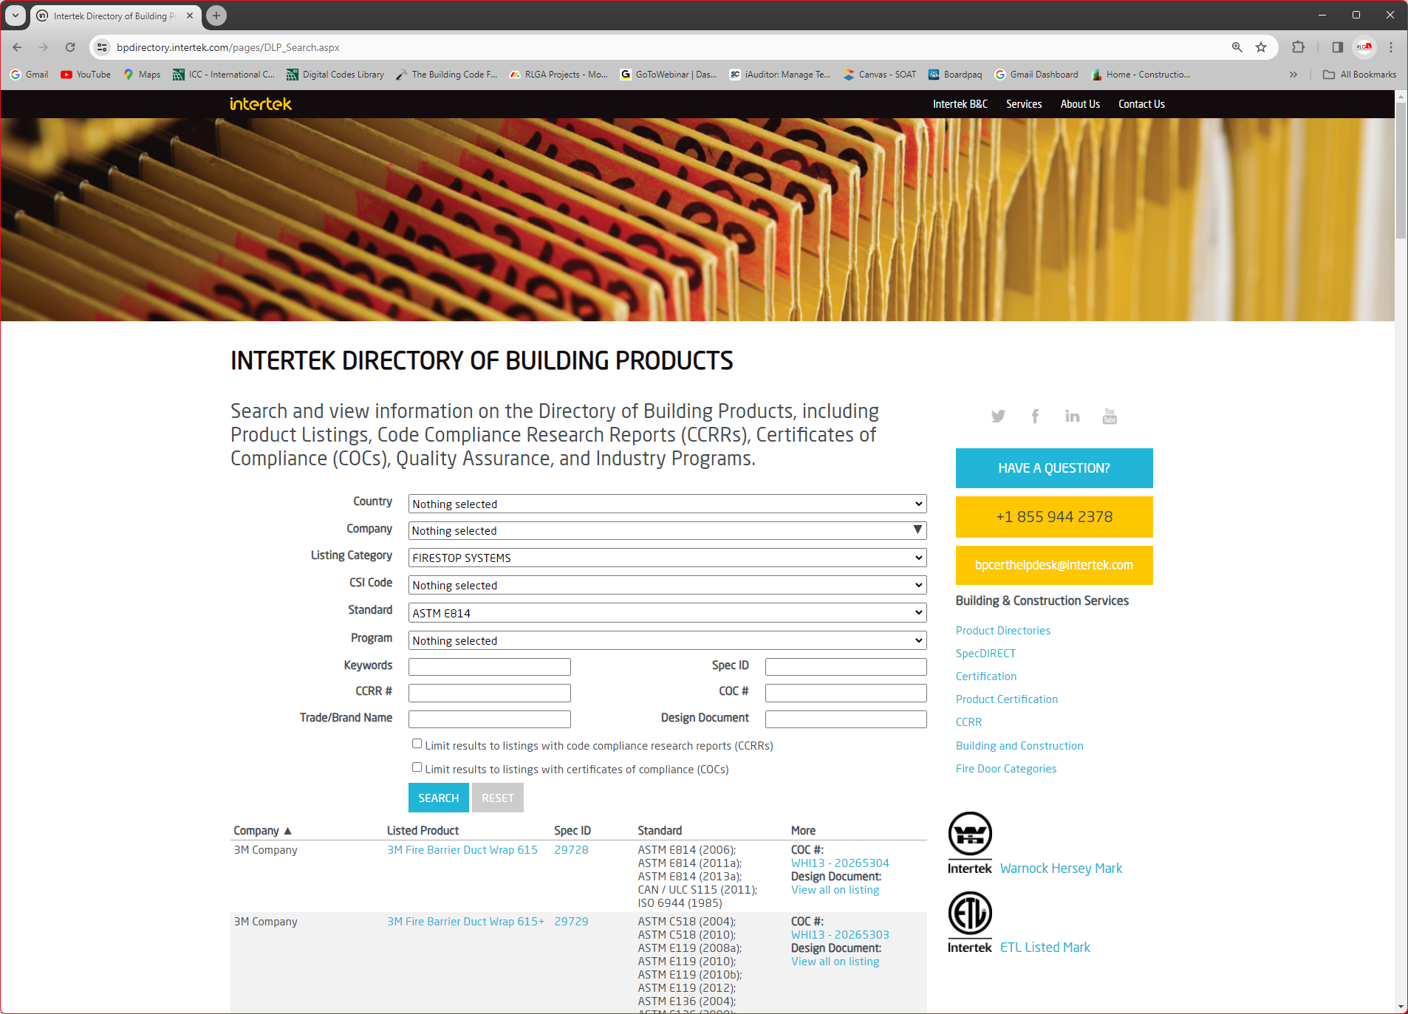
Intertek Directory of Building Products: Firestop System Listing Search

Slide 21
Firestopping & the Construction Documents
What the project requires

Slide 22
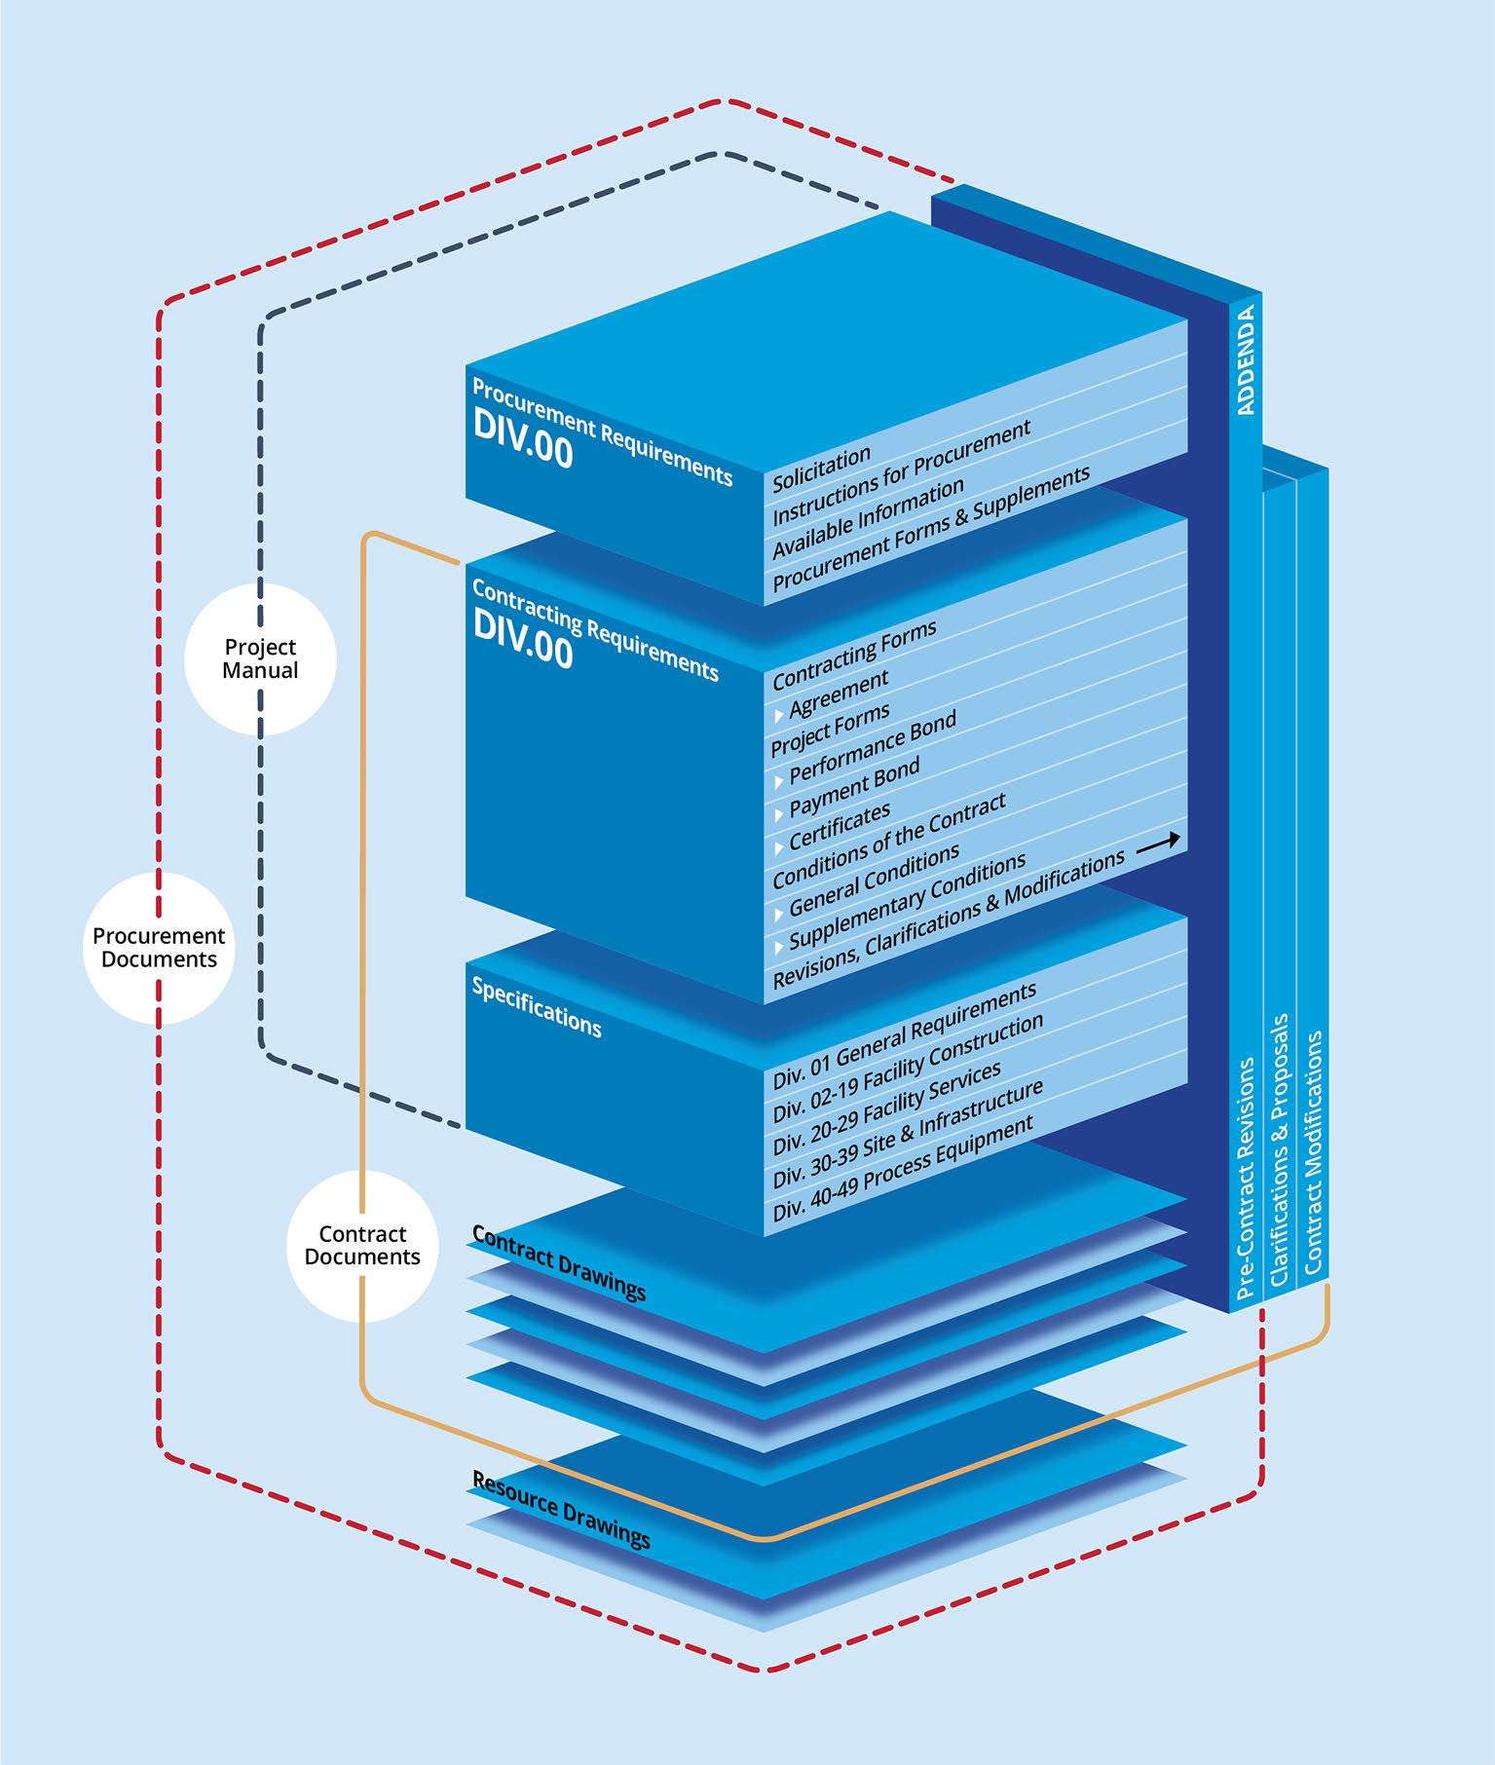
What are Construction Documents?
Illustration from:
Project Delivery Practice Guide, 3rd Edition
Construction Specifications Institute, 2020

Slide 23

Precedence:
  Most general conditions of the contract consider the contract documents to be “complementary”
    “What is required by one shall be as binding as if required by all” (AIA A201)
  However, in situations of conflicting documents, legal interpretations will likely give precedence to the more specific
  Some contracts may establish a predefined precedence
CONTRACT
DRAWINGS
CONTRACT
SPECS

Slide 24

The Contract Drawings
Drawings indicate relationships between building elements and may show the following for materials, assemblies, components, equipment, and accessories:
  Location
  Identification
  Dimension and size
  Details/diagrams of connections
  Shape and form

Slide 25
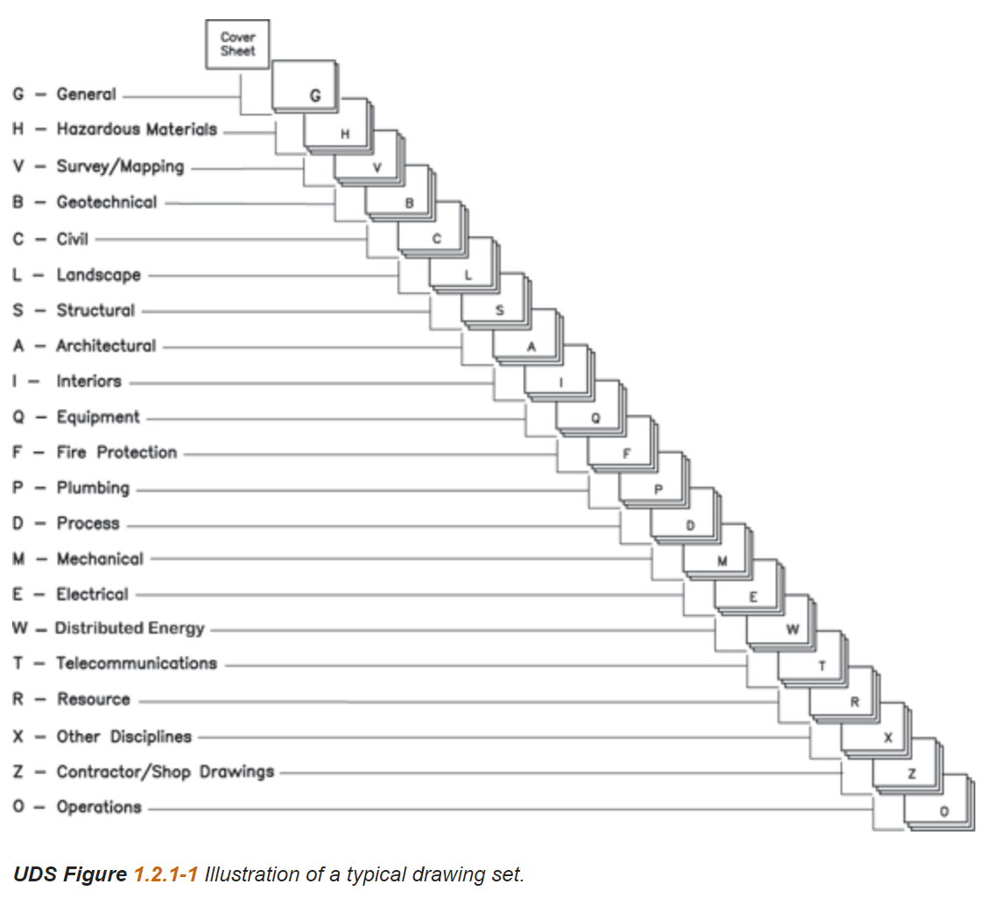
The Contract Drawings
Drawing set organization is not consistent among A/E firms
The location of firestopping requirements in the drawings is not consistent (if provided at all).
Uniform Drawing System (UDS), part of the National CAD Standard

Slide 26
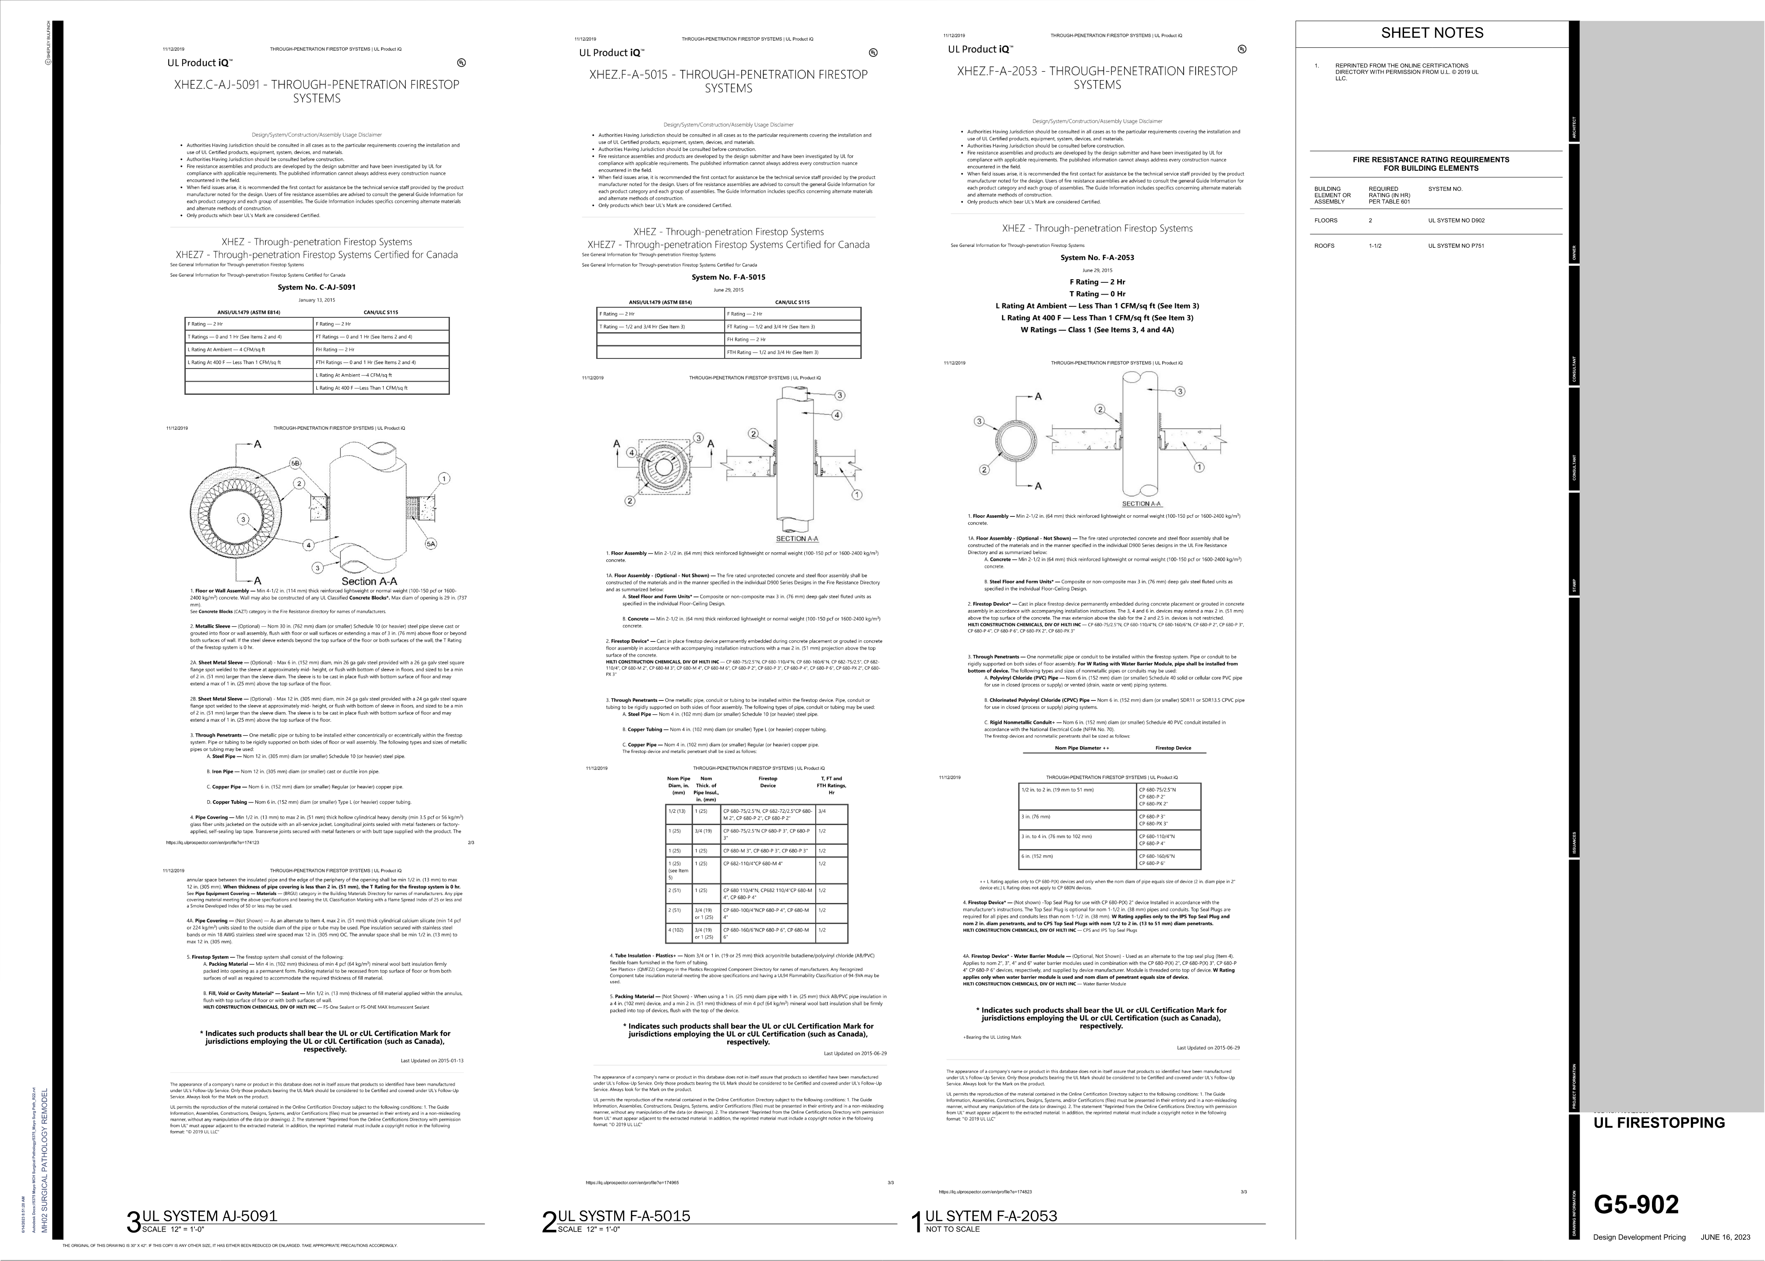
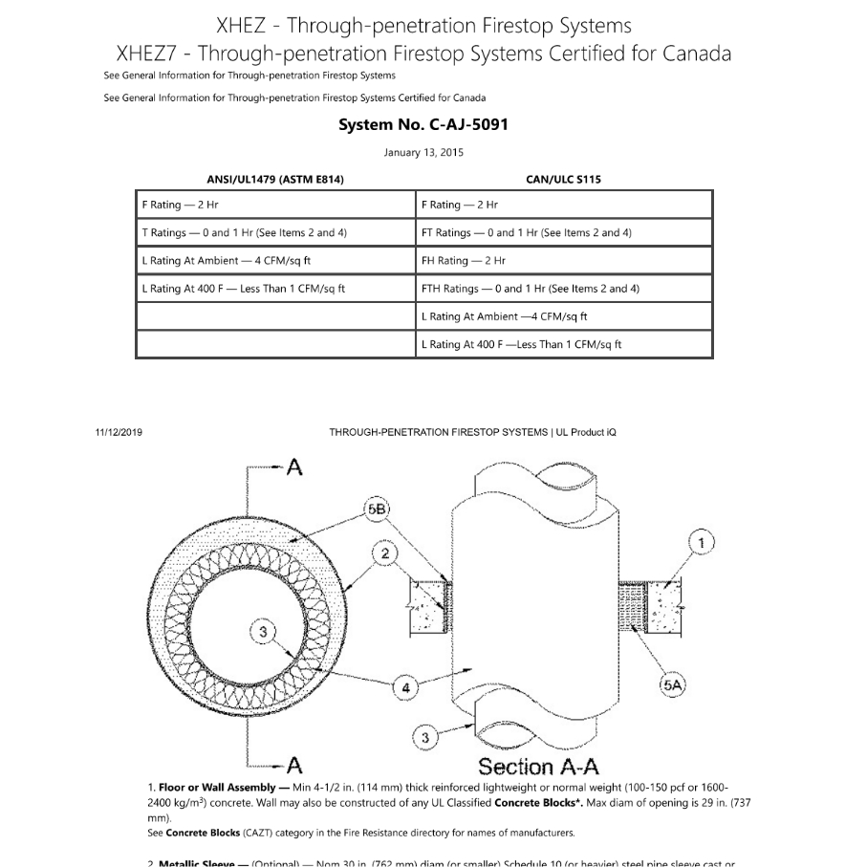
The Contract Drawings
Drawing areas to review:
  G-series or A-series sheets for specific or basis-of-design firestop assemblies

Slide 27
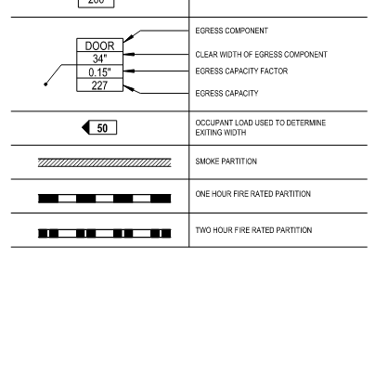
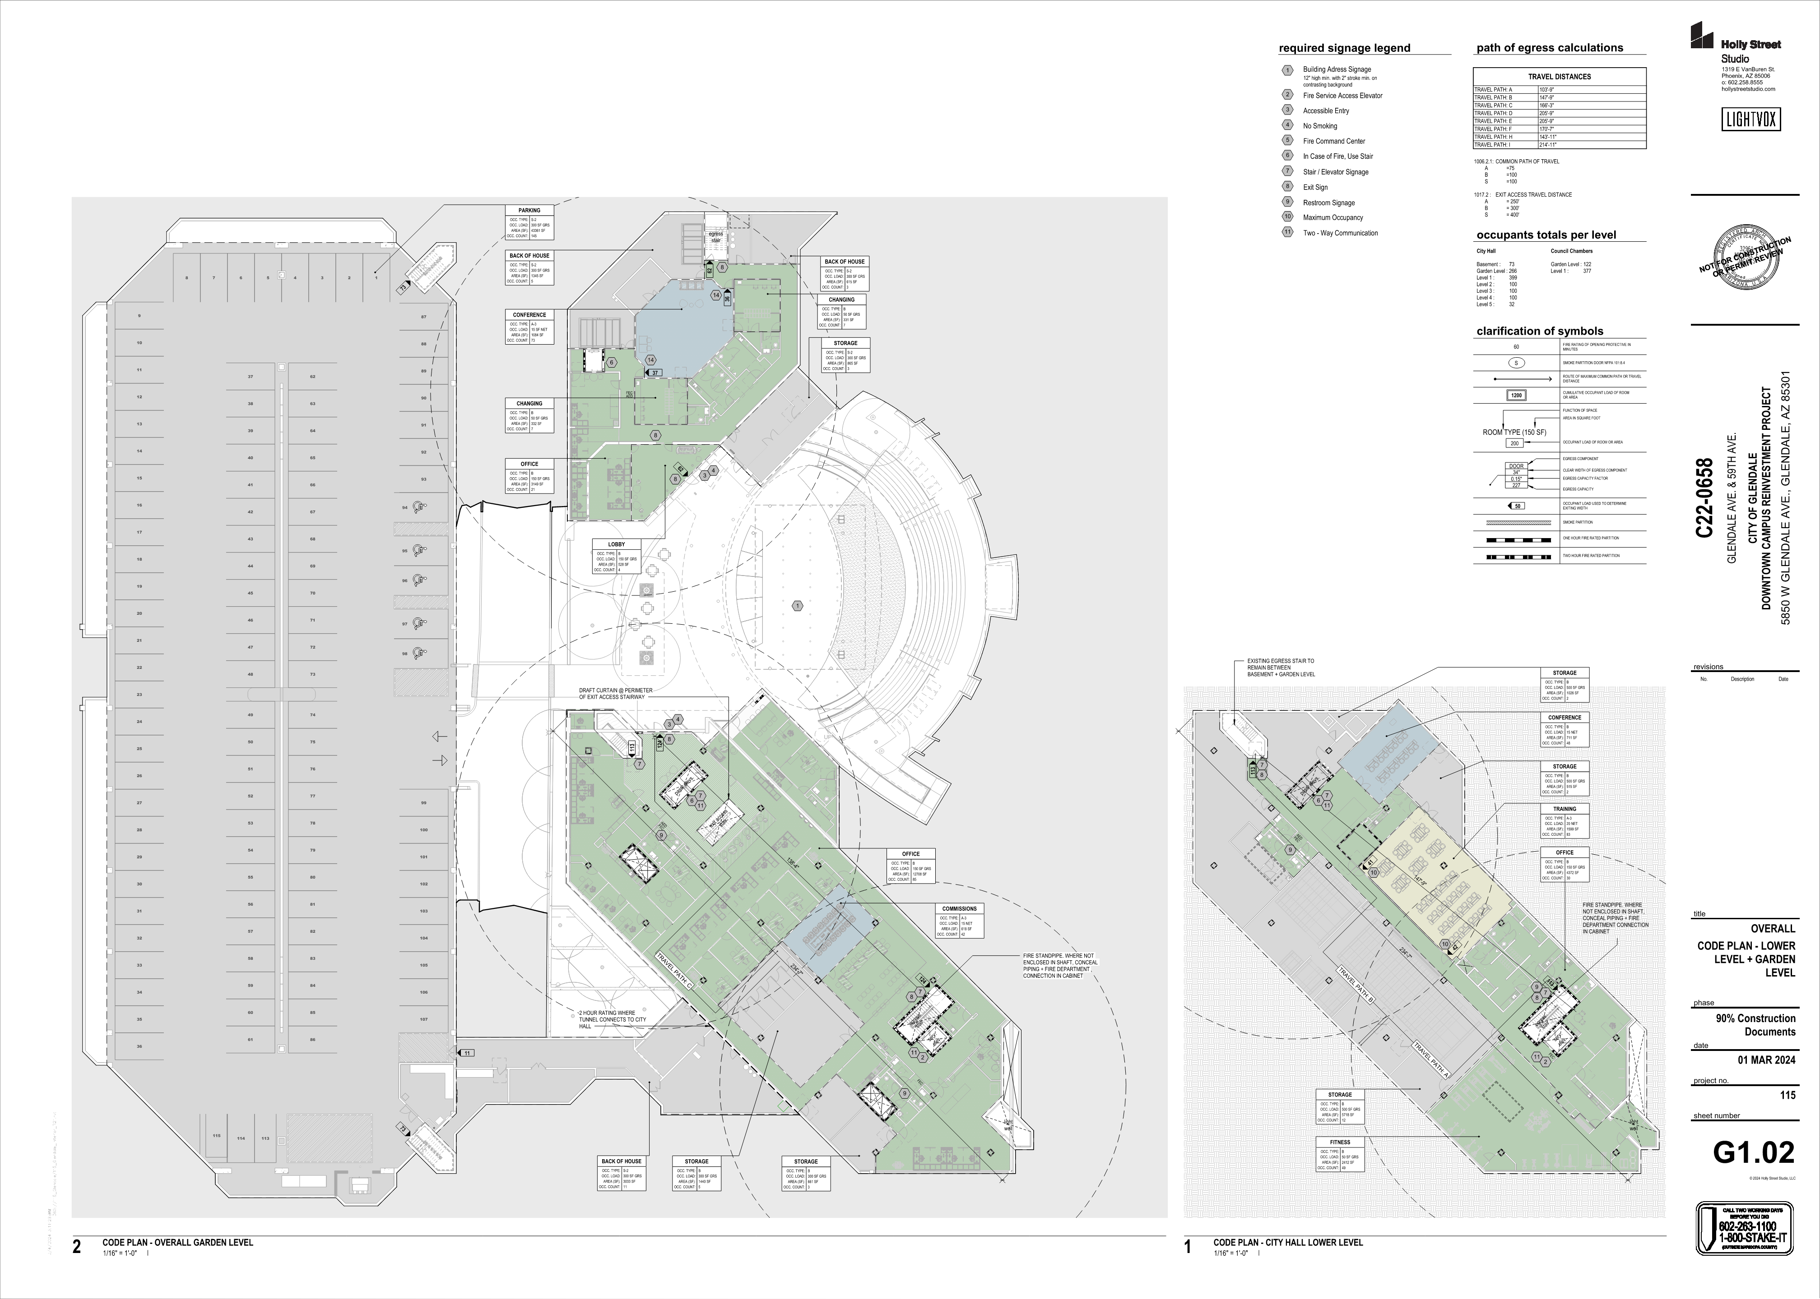
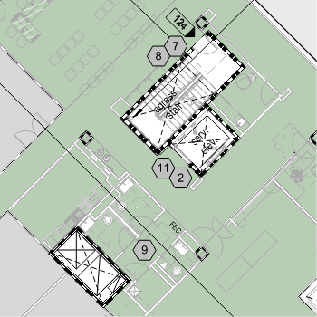
The Contract Drawings
Drawing areas to review:
  G-series or A-series sheets for specific or basis-of-design firestop assemblies
  Code drawings (usually in the G-series) for locations of fire-rated assemblies

Slide 28
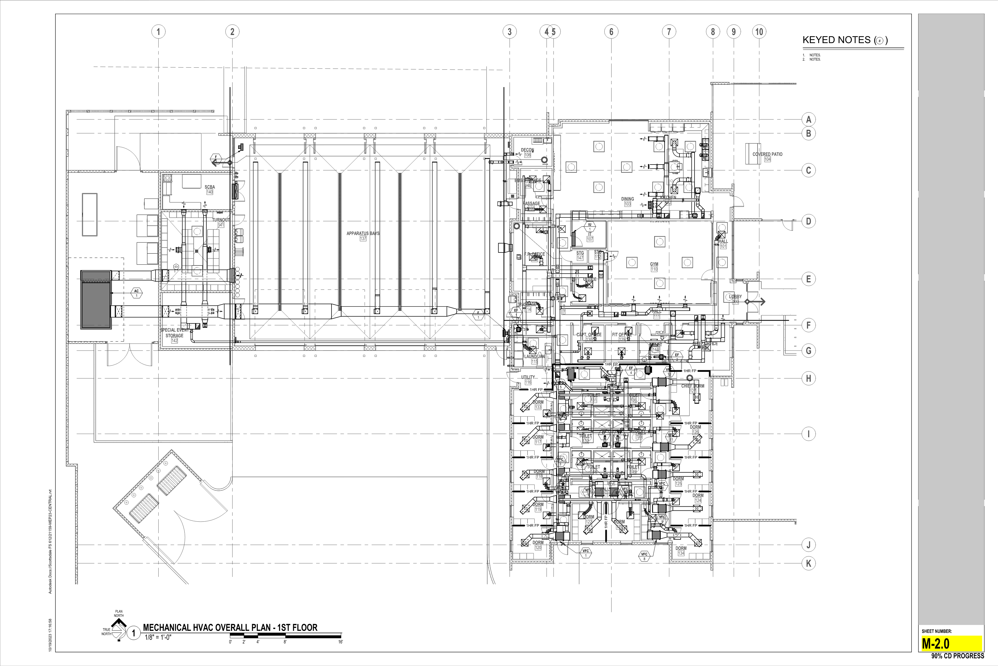
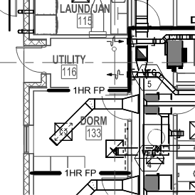
The Contract Drawings
Drawing areas to review:
  G-series or A-series sheets for specific or basis-of-design firestop assemblies
  Code drawings (usually in the G-series) for locations of fire-rated assemblies
  Mechanical, electrical, plumbing, and special systems drawings for routing of ducts, conduit, piping, cabling, etc. through fire-rated assemblies

Slide 29
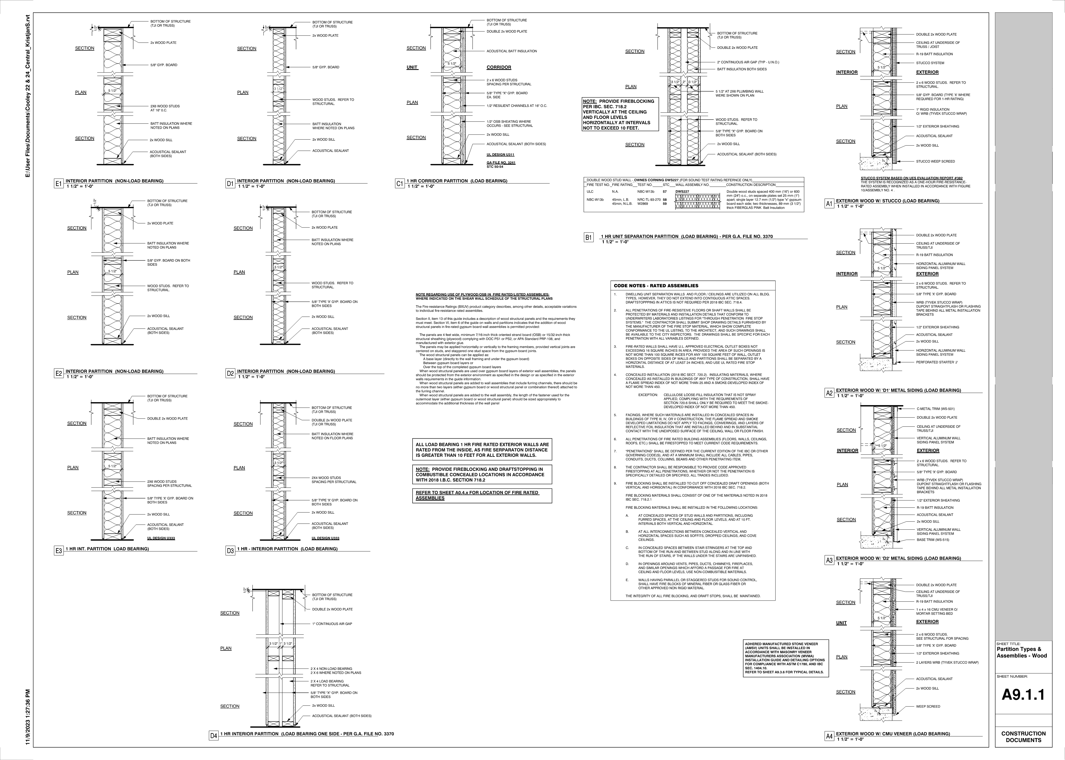
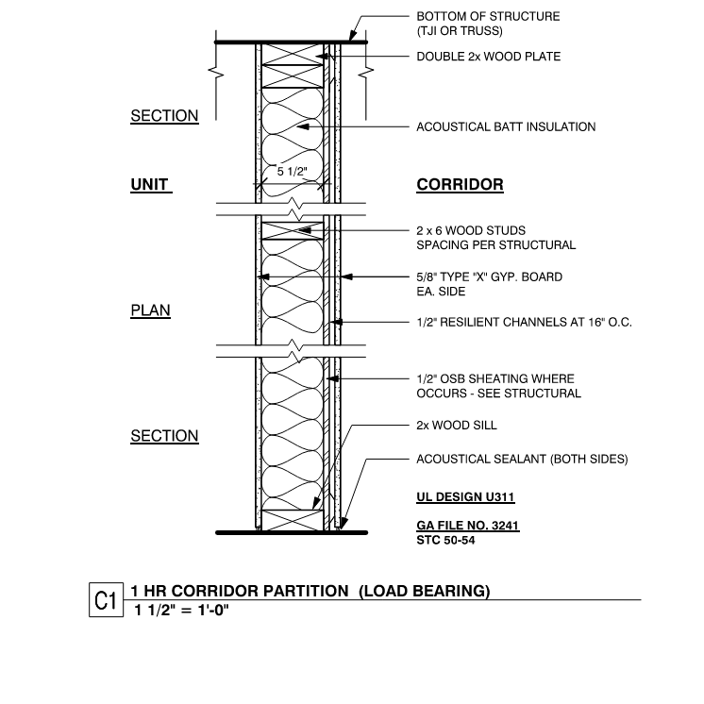
The Contract Drawings
Drawing areas to review:
  G-series or A-series sheets for specific or basis-of-design firestop assemblies
  Code drawings (usually in the G-series) for locations of fire-rated assemblies
  Mechanical, electrical, plumbing, and special systems drawings for routing of ducts, conduit, piping, cabling, etc. through fire-rated assemblies
  Wall, floor, and roof types to determine construction of assemblies

Slide 30
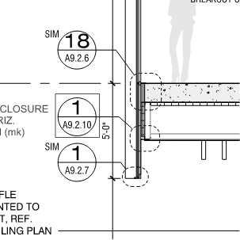
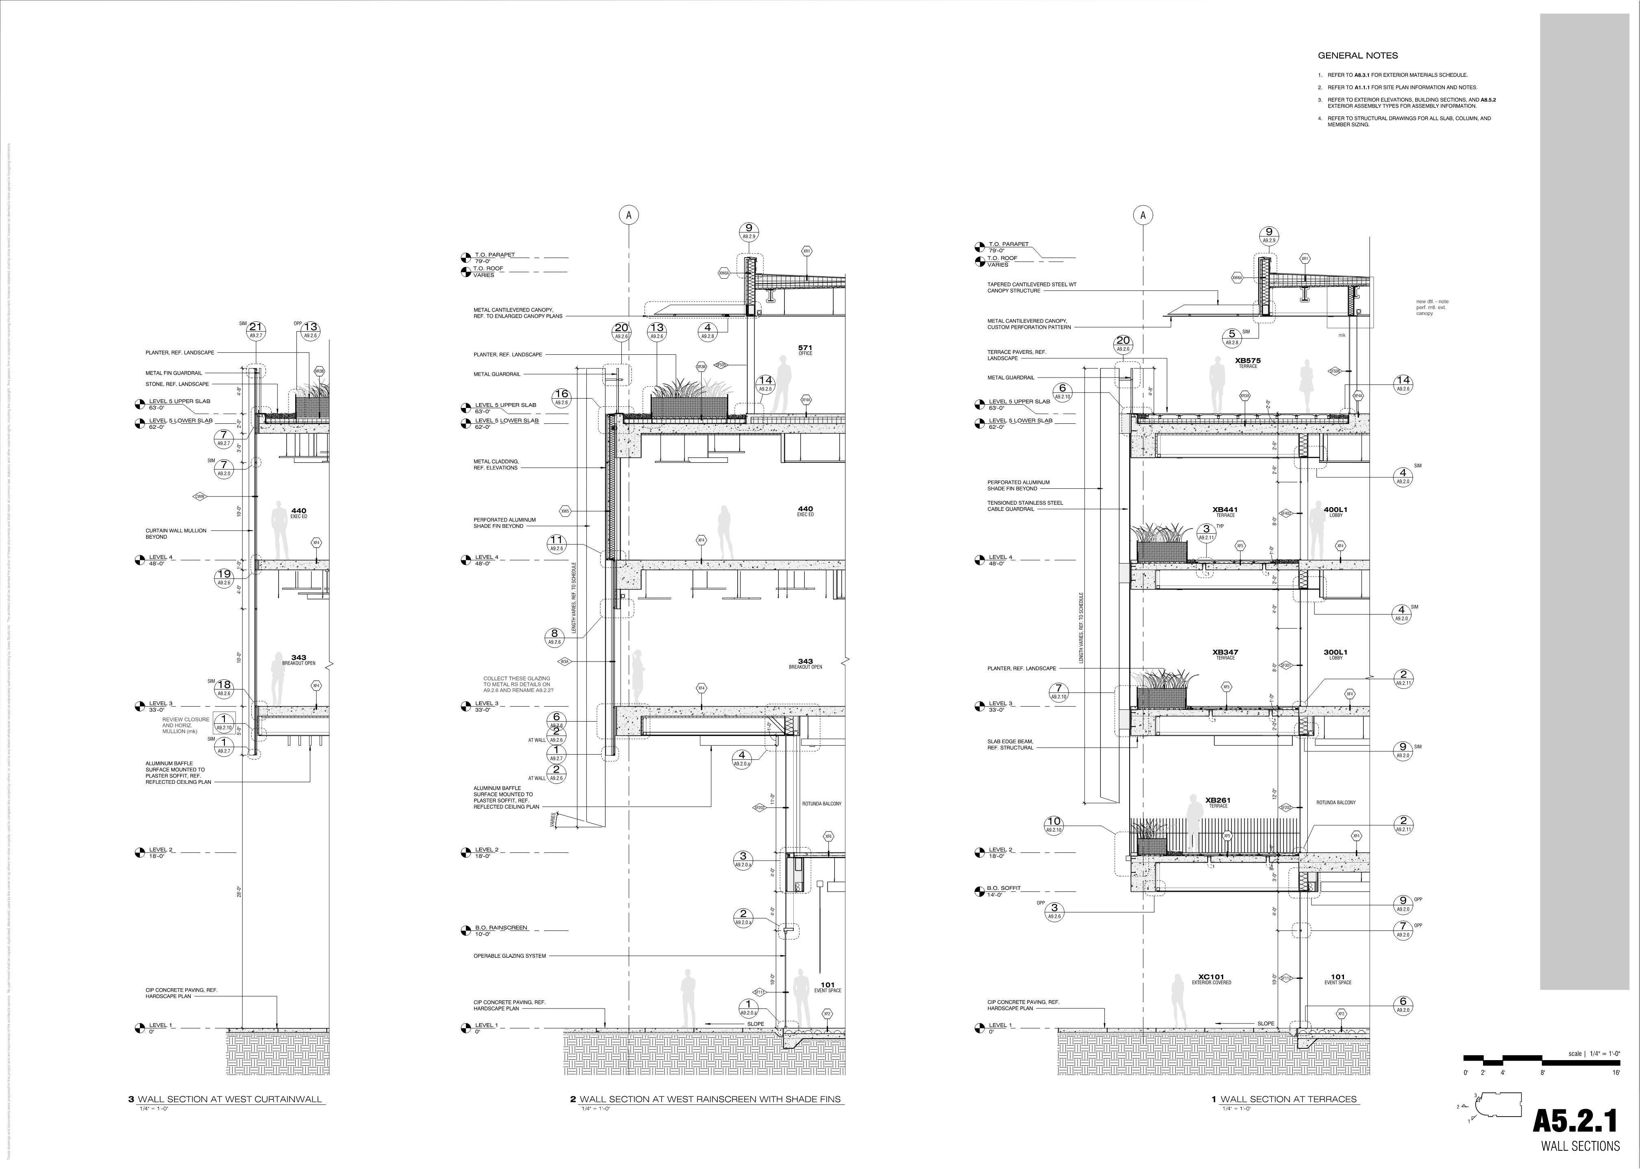
The Contract Drawings
Drawing areas to review:
  G-series or A-series sheets for specific or basis-of-design firestop assemblies
  Code drawings (usually in the G-series) for locations of fire-rated assemblies
  Mechanical, electrical, plumbing, and special systems drawings for routing of ducts, conduit, piping, cabling, etc. through fire-rated assemblies
  Wall, floor, and roof types to determine construction of assemblies
  Wall sections for perimeter fire-containment system conditions

Slide 31
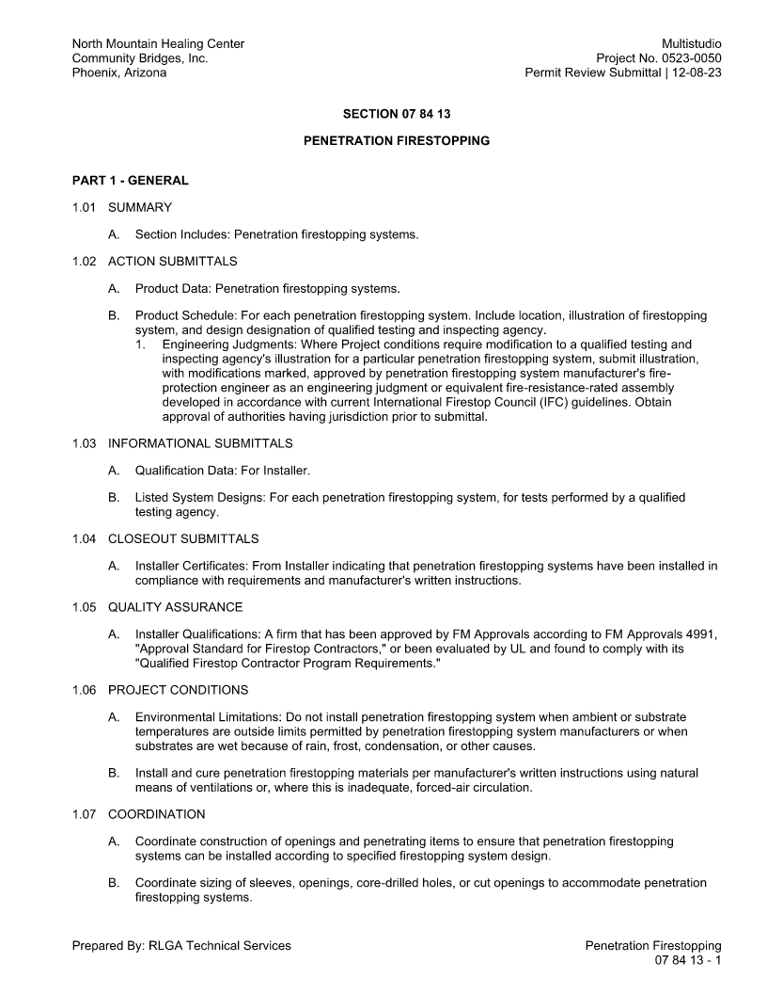
The Contract Specifications
Specifications detail the qualitative requirements for products, materials, and equipment
There are four methods of specifying:
  Performance
  Descriptive
  Reference standard
  Proprietary

Slide 32
The Contract Specifications
In many cases, a firestop specification will utilize all four of the methods:
    Performance:
      “F-Rating: Not less than the fire-resistance rating of the wall penetrated.”
    Descriptive:
      “Provide components for each penetration firestopping system that do not contain ethylene glycol.”
    Reference Standard:
      “Penetrations in Fire-Resistance-Rated Walls: Penetration firestopping systems with ratings determined in accordance with ASTM E814 or UL 1479.”
    Proprietary:
      “Manufacturers: Subject to compliance with requirements, provide products by one of the following:
        “ABC Company.
        “LMNOP Inc.
        “XYZ International.”

Slide 33

The Contract Specifications
Firestopping requirements are specified in Division 07 in the following possible sections:
  07 84 00—Firestopping
    07 84 13—Penetration Firestopping
    07 84 43—Joint Firestopping (may include building perimeter firestopping)
    07 84 53—Building Perimeter Firestopping
Lesser-known firestop specification sections:
  07 05 53—Fire and Smoke Assembly Identification
  07 06 80—Schedules for Fire and Smoke Protection
    07 06 80.16—Firestopping Schedule

Slide 34
The Contract Specifications
Firestopping requirements may also be found in the following locations:
  Division 21 – Fire Suppression
  Division 22 – Plumbing
  Division 23 – Heating, Ventilating, and Air Conditioning (HVAC)
  Division 26 – Electrical
  Division 27 – Communications
  Division 28 – Electronic Safety and Security
Requirements in the above follow the “you poke it, you patch it” concept

Slide 35
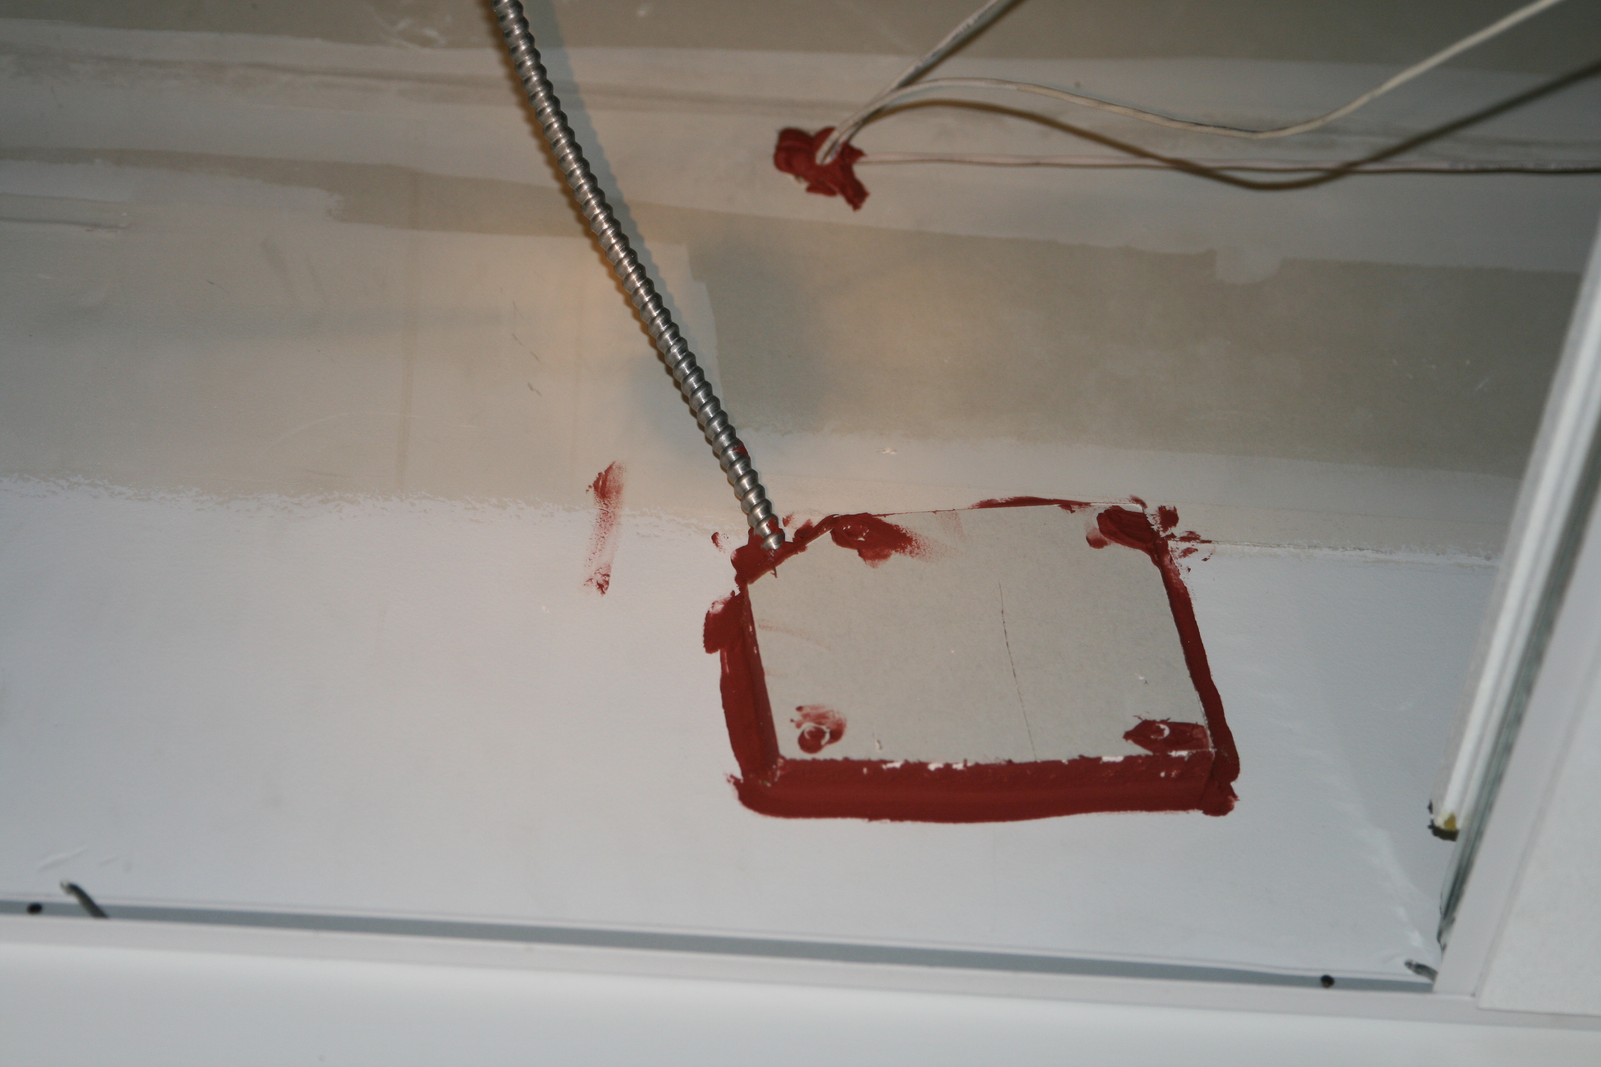
The Contract Specifications
Firestopping requirements may also be found in the following locations:
  Division 21 – Fire Suppression
  Division 22 – Plumbing
  Division 23 – Heating, Ventilating, and Air Conditioning (HVAC)
  Division 26 – Electrical
  Division 27 – Communications
  Division 28 – Electronic Safety and Security
Requirements in the above follow the “you poke it, you patch it” concept
The idea is to avoid this type of installation

Slide 36
The Contract Specifications
Firestopping requirements may also be found in the following locations:
  Division 21 – Fire Suppression
  Division 22 – Plumbing
  Division 23 – Heating, Ventilating, and Air Conditioning (HVAC)
  Division 26 – Electrical
  Division 27 – Communications
  Division 28 – Electronic Safety and Security
Requirements in the above follow the “you poke it, you patch it” concept
Best Practice is to keep all firestopping requirements in Division 07.

Slide 37

The Contract Specifications
A specification section is separated into three PARTS:
  PART 1 – GENERAL
    “Describes administrative and procedural requirements unique to the section. Part 1 expands on subjects covered in Division 01, adding information unique to the section.”
  PART 2 – PRODUCTS
    “Describes the systems, assemblies, equipment, products, materials, fabrications, and mixes that are to be incorporated into the project.”
  PART 3 – EXECUTION
    “Describes field/site installation or application, including preparatory actions and post-installation cleaning and protection. Field/site-built assemblies and field/site-manufactured products and systems are included.”

Slide 38
The Contract Specifications
PART 1 – GENERAL
Pay particular attention to the following:
  Submittals (Also look at Section 01 33 00—Submittal Procedures)
    Product data
    Engineering judgments
    Qualification data (based on Quality Assurance requirements)
    Installer certificates
  Administrative Requirements
    Preinstallation Meetings – May be required; however, whether in the specifications or not, the Appendices in ASTM E2174 and ASTM E2393 state “pre-construction” meetings should be held

Slide 39
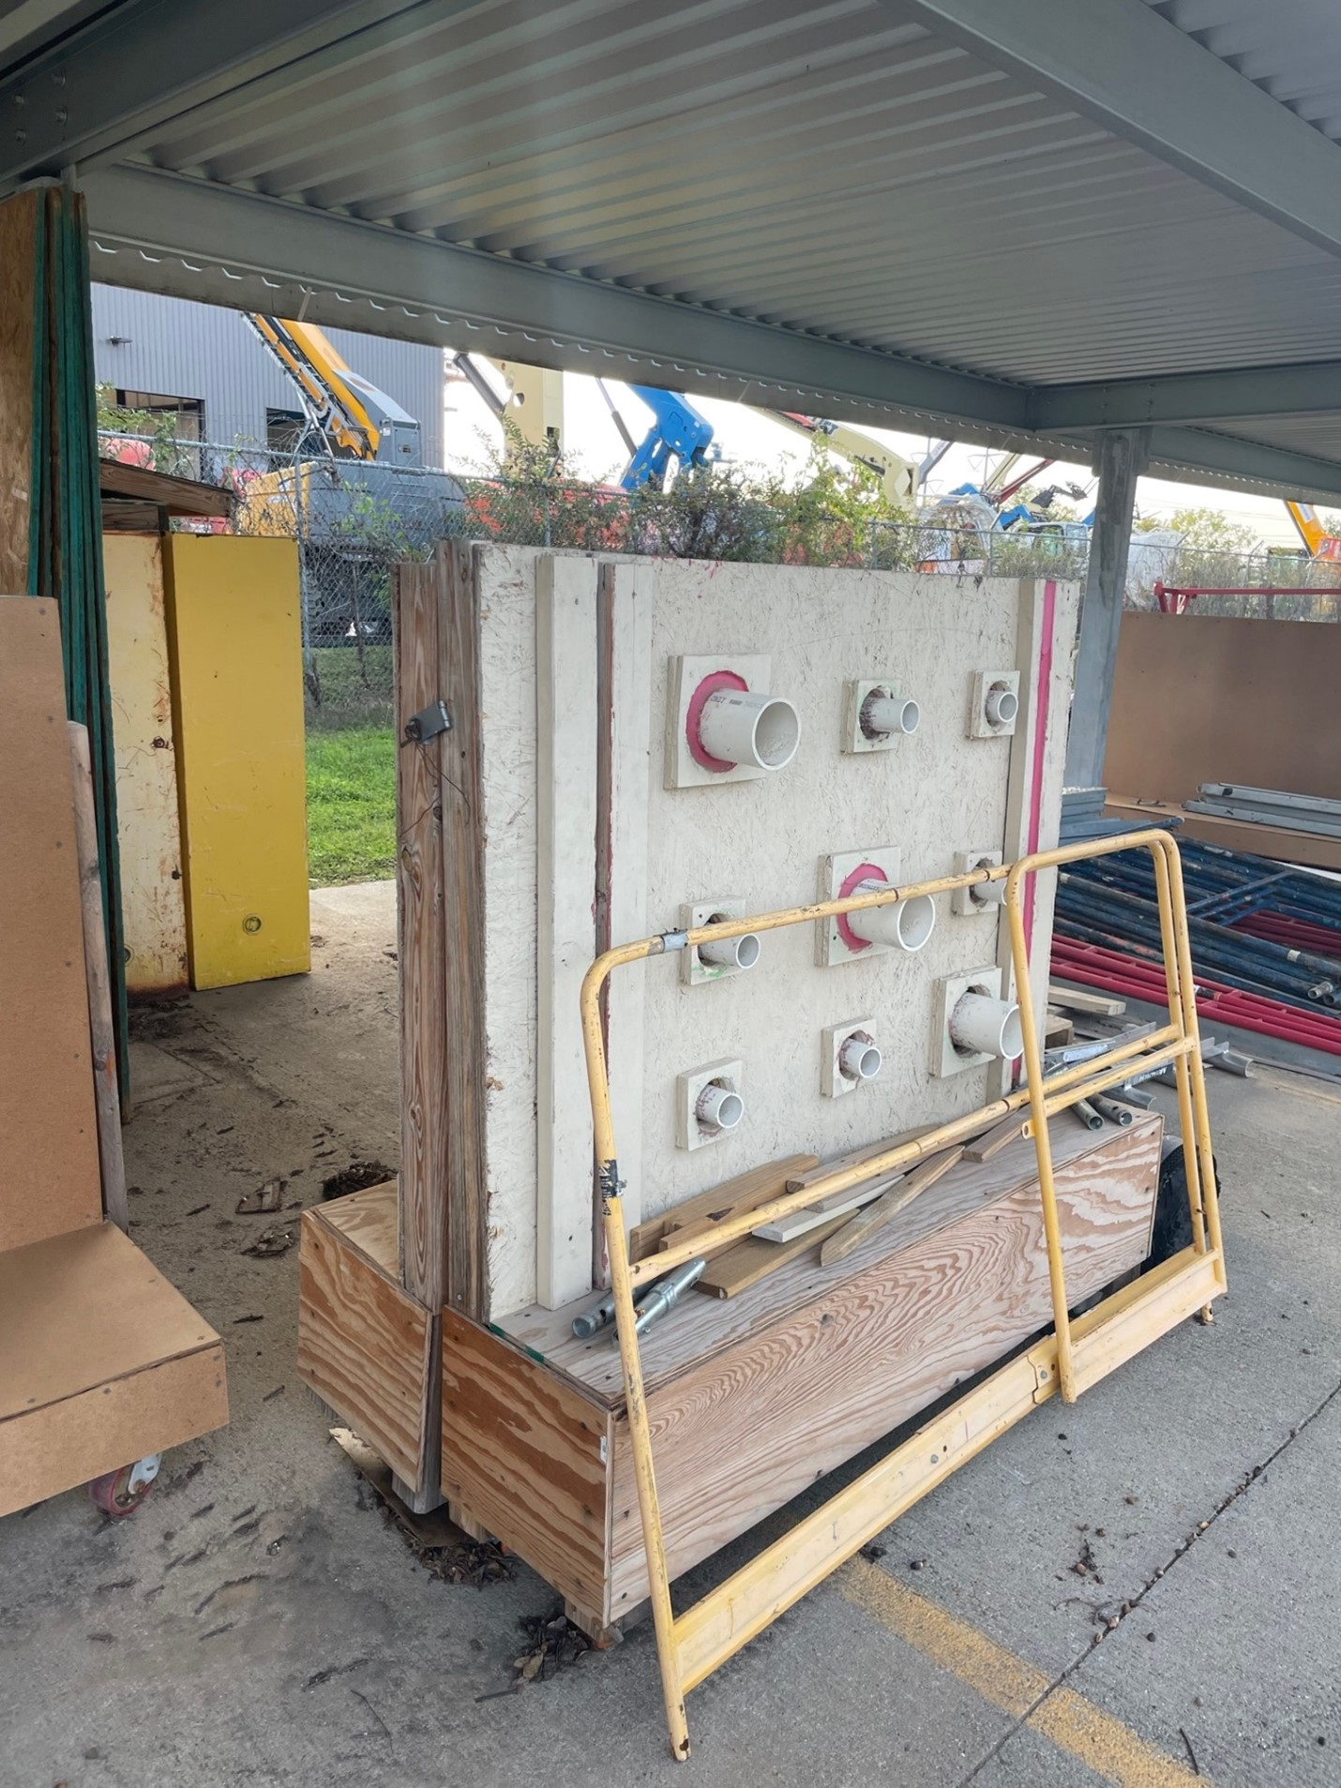
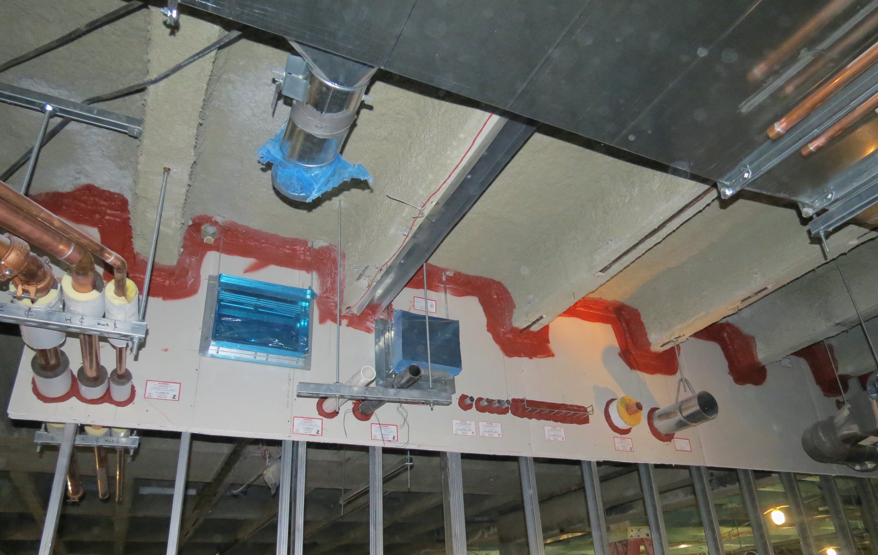
The Contract Specifications
PART 1 – GENERAL
Pay particular attention to the following: (cont.)
  Quality Assurance
    Installer qualifications – FM-Approved per FM 4991 or UL Solutions Qualified Firestop Contractor Program
    Mockups – May be required if appearance or quality of installation is important

Slide 40
The Contract Specifications
PART 2 – PRODUCTS
Pay particular attention to the following:
  Manufacturers/Products: May be proprietary or descriptive
    May be limited by assemblies shown on drawings or listed in a schedule
    Substitutions, if permitted, must comply with Section 01 25 00—Substitution Procedures
  Ratings: As indicated on drawings, as listed in a schedule, or as specified
    May require ratings not required by code, such as:
      M-Rating for movement capability per ASTM E3037 “Standard Test Method For Measuring Relative Movement Capabilities Of Through-Penetration Firestop Systems”
      W-Rating for water resistance per UL 1479

Slide 41
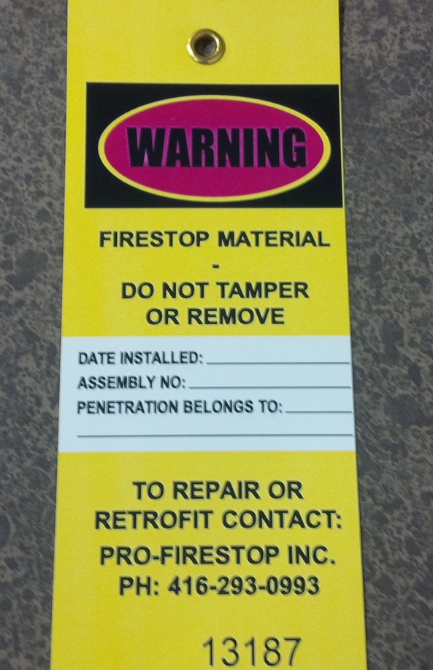
The Contract Specifications
PART 3 – EXECUTION
Pay particular attention to the following:
  Identification: Labeling of firestop systems
  Special Inspection: May mention that systems are subject to special inspections
    Owner-provided and not a requirement of the Installer
    Inspected according to the following:
      ASTM E2174 “Standard Practice for On-Site Inspection of Installed Firestops”
      ASTM E2393 “Standard Practice for On-Site Inspection of Installed Fire Resistive Joint Systems and Perimeter Fire Barriers”
    Installer must make necessary corrections

Slide 42

Quality Assurance (QA) &
Quality Control (QC)
QA:
“ The procedures for guarding against construction defects and deviations from the contract documents before and during the execution of the work.”
QC:
“ The procedures for evaluating completed activities and elements of the work for conformance with contract requirements.”
Quotes are from CSI’s Project Delivery Practice Guide, 3rd Edition

Slide 43
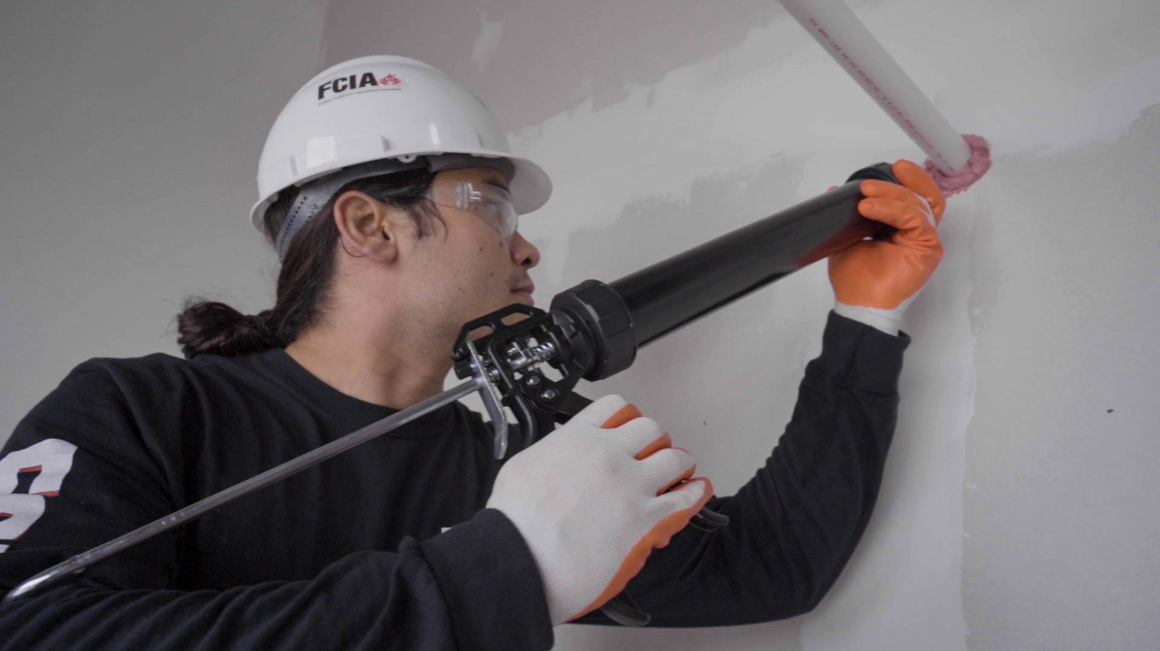


Quality Assurance/Quality Control
Contractors/Installers:
  FM-Approved Firestop Contractors
  UL Solutions Qualified Firestop Contractor Program
Benefits:
  Breeds an environment where firestop systems are installed correctly the first time and function as intended should they be called upon by fire and/or smoke
  Owners and design professionals have elevated levels of confidence
  Ensures consistency throughout the facility

Slide 44
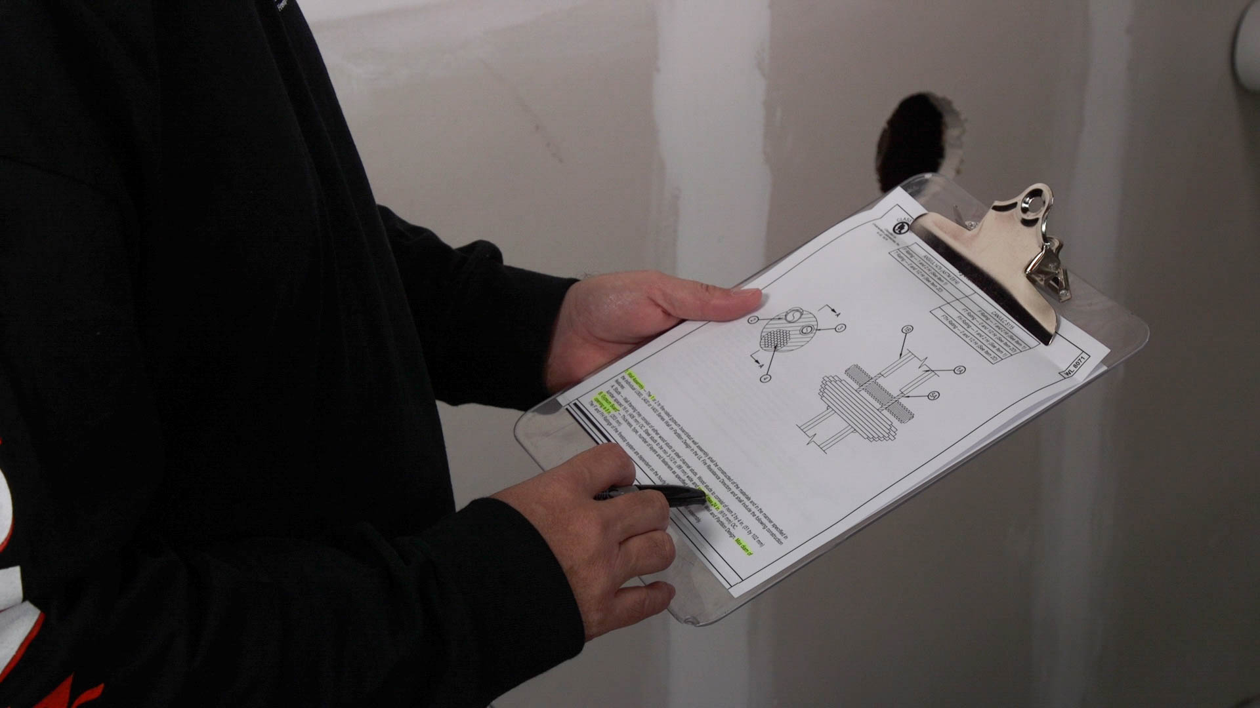

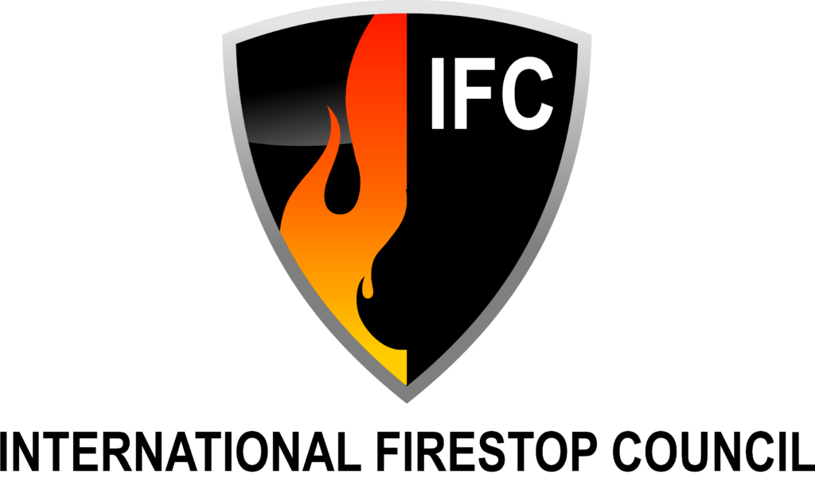

Quality Assurance/Quality Control
Special Inspection Agency Approval:
  IAS Special Inspector Accreditation
Special Inspector Approval:
  IFC Firestop Inspector Certificate/Premier Certificate
  ICC Firestopping Credential of Learning Achievement (CLA)
    Applicable for certificants of the following:
      UL, FM, or IFC programs (also by WABO for Washington state residents)
      ICC Certified Building Plans Examiner/Inspector, Combo Plans Examiner/Inspector, MCP, or any ICC Special Inspector
      OSHPD California Inspector Certification

Slide 45
QUESTIONS?
RONALD L. GEREN
FCSI, DISTINGUISHED MEMBER, AIA, CCS, CCCA, CDT, SCIP
OWNER
ron@specsandcodes.com

