Slide 1
Protecting Joints and Voids in Fire-Resistive Construction
FCIA
Webinar
Series
Bill McHugh, Executive Director of FCIA
Rich Walke, CTI, Consultant to FCIA
Notes:
FCIA Members consist of….
FCIA offers a free FCIA Firestop Manual of Practice to Specifiers with Design Firms, Authorities Having Jurisdiction with governmental agencies, independent specifiers as a service to the industry.
FCIA’s Life Safety Digest, the only magazine that focuses on effective compartmentation, is available to all free electronically. This magazine is the only publication that has fire-resistance as it’s editorial content.
FCIA was the originator of ASTM E 2174 and ASTM E 2393, Standards for Firestop Inspection. FCIA was the code proponent to put ASTM E 2174 and ASTM E 2393 into the International Building Code in the USA and other countries. We chair the two standards task group at ASTM.
FCIA Built the FM 4991, UL Qualified Firestop Contractor Programs to build better quality installations through a management system approach to subcontracting industry. This is the first of its kind in the construction industry.
FCIA built the firestop section of International Accreditation Services IAS AC 291, a management system program for inspection agencies.
FCIA also endorses the FM and UL Firestop Exams for education of contractor and inspection agency personnel.
In addition, FCIA’s Firestop Containment Worker Program provides firestop contractors an organized curriculum for educating their workforce.
There are tools for the industry, FREE to all, from a 07-84-00 Firestop Specification to the Life Safety Digest, an open website with links to a video on the Barrier Management Symposium joint venture with ASHE, TJC, UL and FCIA. FCIA advocates for fire and life safety through the DIIM of Firestopping – and works with other effective compartmentation industries to provide a complete safe building.

Slide 2
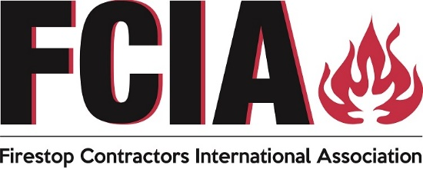
FCIA – Firestop Contractors
International Association
Fire Exits??
Housekeeping….Phones, Hands off Keyboard!
Thanks to FCIA Members
  Firestop Contractors
  Manufacturers, Consultants
  Firestop Distributors, Reps, Friends
FREE PDF MOP/ Word Doc Spec - Specifiers @ Architect/Engineering firms, Independent Specifiers, AHJ’s with Municipality Jurisdictions, More
Notes:
FCIA Members consist of….
FCIA offers a free FCIA Firestop Manual of Practice to Specifiers with Design Firms, Authorities Having Jurisdiction with governmental agencies, independent specifiers as a service to the industry.
FCIA’s Life Safety Digest, the only magazine that focuses on effective compartmentation, is available to all free electronically. This magazine is the only publication that has fire-resistance as it’s editorial content.
FCIA was the originator of ASTM E 2174 and ASTM E 2393, Standards for Firestop Inspection. FCIA was the code proponent to put ASTM E 2174 and ASTM E 2393 into the International Building Code in the USA and other countries. We chair the two standards task group at ASTM.
FCIA Built the FM 4991, UL Qualified Firestop Contractor Programs to build better quality installations through a management system approach to subcontracting industry. This is the first of its kind in the construction industry.
FCIA built the firestop section of International Accreditation Services IAS AC 291, a management system program for inspection agencies.
FCIA also endorses the FM and UL Firestop Exams for education of contractor and inspection agency personnel.
In addition, FCIA’s Firestop Containment Worker Program provides firestop contractors an organized curriculum for educating their workforce.
There are tools for the industry, FREE to all, from a 07-84-00 Firestop Specification to the Life Safety Digest, an open website with links to a video on the Barrier Management Symposium joint venture with ASHE, TJC, UL and FCIA. FCIA advocates for fire and life safety through the DIIM of Firestopping – and works with other effective compartmentation industries to provide a complete safe building.

Slide 3
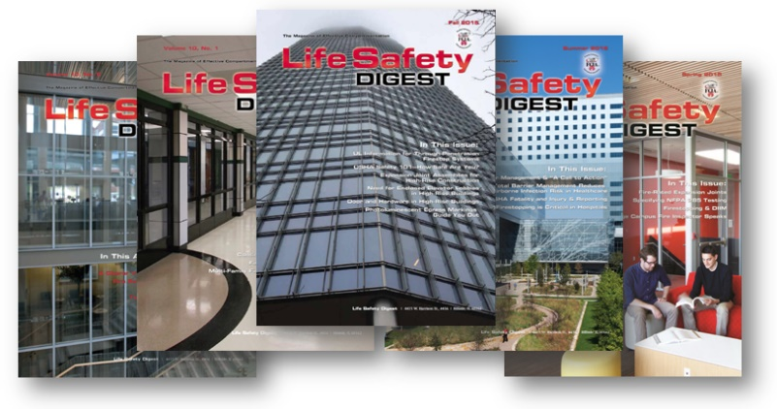
FCIA – Firestop Contractors
International Association
FREE Life Safety Digest
UL/ULC, FM 4991 Contractor Programs,
IAS AC 291 Inspection Agency
Accreditation Program, Individual Knowledge
ASTM Inspection Standards – ASTM E2174 & ASTM E2393
  High Rise, Category III & IV, R>250 (‘21), NFPA 1, NFPA 101 Appx. Specs Worldwide
Tools @ FCIA.org for Specifiers, AHJ’s, Building Owners, Firestop Contractors & Inspection Agencies
Watch FCIA.org for Webinar Announcements!
Notes:
FCIA Members consist of….
FCIA offers a free FCIA Firestop Manual of Practice to Specifiers with Design Firms, Authorities Having Jurisdiction with governmental agencies, independent specifiers as a service to the industry.
FCIA’s Life Safety Digest, the only magazine that focuses on effective compartmentation, is available to all free electronically. This magazine is the only publication that has fire-resistance as it’s editorial content.
FCIA was the originator of ASTM E 2174 and ASTM E 2393, Standards for Firestop Inspection. FCIA was the code proponent to put ASTM E 2174 and ASTM E 2393 into the International Building Code in the USA and other countries. We chair the two standards task group at ASTM.
FCIA Built the FM 4991, UL Qualified Firestop Contractor Programs to build better quality installations through a management system approach to subcontracting industry. This is the first of its kind in the construction industry.
FCIA built the firestop section of International Accreditation Services IAS AC 291, a management system program for inspection agencies.
FCIA also endorses the FM and UL Firestop Exams for education of contractor and inspection agency personnel.
In addition, FCIA’s Firestop Containment Worker Program provides firestop contractors an organized curriculum for educating their workforce.
There are tools for the industry, FREE to all, from a 07-84-00 Firestop Specification to the Life Safety Digest, an open website with links to a video on the Barrier Management Symposium joint venture with ASHE, TJC, UL and FCIA. FCIA advocates for fire and life safety through the DIIM of Firestopping – and works with other effective compartmentation industries to provide a complete safe building.

Slide 4
FCIA Actions - 2022
Conferences - HYBRID
  FCIA ECA @ Nashville, USA – May 18-20
  FCIA ME @ Doha, Dubai – June 19-25
  FCIA CAN @ VANCOUVER – Early Oct.
  FCIA FIC @ Amelia Island, FL – Nov. 2-4
Webinars & Symposiums
Code Development & Standards Discussions
Committee Action
International Discussions
NEW Education for Careers in Firestopping!!
  FCIA’s Firestop Certificate of Achievement & Education Program
Notes:
Here’s what we’ll be discussing today.
Who’s FCIA?
Total Fire Protection and Effective Compartmentation
Codes, Testing and Materials– We will present a VERY SHORT description of materials, SYSTEMS, and problems about getting Firestop systems installed with zero tolerance in the field.
Firestopping and Compartmentation for Life Safety
Things you should know about when specifying, buying a firestop system, installed as a system.
The Quality Process, SubContractor Quality processes..
FM 4991 Approved Contractors and how they fit into
What you should look for in a firestop contractor professional
Inspection process – New ASTM E2174 and ASTM E2393 for penetration and joints protocol.
Maintenance – Every component of a project needs maintenance. Firestopping and Effective Compartmentation are no different.
The complete firestopping process quality protocol for the life of the building means,
Firestopping Designed Properly,
Tested and Listed in public directories by accredited laboratories and FCIA Member Manufacturers
Inspected by professionals to ASTM E2174 / 2393 Protocol
Maintained by FCIA Member, FM 4991 Contractors
This Firestopping Quality process includes the complete cycle of quality from manufacture through service life of the building.
Recipe for success of a firestop project – A correct specification. FCIA’s Firestop Spec is available at www.fcia.org

Slide 5
FCIA Actions - 2022
NEW Education for Careers in Firestopping!!
  FCIA’s Firestop Certificate of Achievement
    4 Levels
    Career Path Education
  FCIA Education Respected Worldwide
Notes:
Here’s what we’ll be discussing today.
Who’s FCIA?
Total Fire Protection and Effective Compartmentation
Codes, Testing and Materials– We will present a VERY SHORT description of materials, SYSTEMS, and problems about getting Firestop systems installed with zero tolerance in the field.
Firestopping and Compartmentation for Life Safety
Things you should know about when specifying, buying a firestop system, installed as a system.
The Quality Process, SubContractor Quality processes..
FM 4991 Approved Contractors and how they fit into
What you should look for in a firestop contractor professional
Inspection process – New ASTM E2174 and ASTM E2393 for penetration and joints protocol.
Maintenance – Every component of a project needs maintenance. Firestopping and Effective Compartmentation are no different.
The complete firestopping process quality protocol for the life of the building means,
Firestopping Designed Properly,
Tested and Listed in public directories by accredited laboratories and FCIA Member Manufacturers
Inspected by professionals to ASTM E2174 / 2393 Protocol
Maintained by FCIA Member, FM 4991 Contractors
This Firestopping Quality process includes the complete cycle of quality from manufacture through service life of the building.
Recipe for success of a firestop project – A correct specification. FCIA’s Firestop Spec is available at www.fcia.org

Slide 6
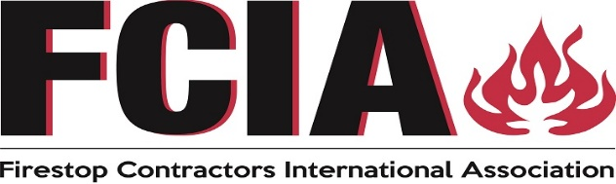
FCIA – Firestop Contractors
International Association
Thanks FCIA Members
  Firestop Contractors
  Manufacturers, Consultants
  Firestop Distributors, Reps, Friends
FREE PDF MOP/ Word Doc Spec - Specifiers @ AE, Independents, AHJ’s with Jurisdictions, More
Notes:
FCIA Members consist of….
FCIA offers a free FCIA Firestop Manual of Practice to Specifiers with Design Firms, Authorities Having Jurisdiction with governmental agencies, independent specifiers as a service to the industry.
FCIA’s Life Safety Digest, the only magazine that focuses on effective compartmentation, is available to all free electronically. This magazine is the only publication that has fire-resistance as it’s editorial content.
FCIA was the originator of ASTM E 2174 and ASTM E 2393, Standards for Firestop Inspection. FCIA was the code proponent to put ASTM E 2174 and ASTM E 2393 into the International Building Code in the USA and other countries. We chair the two standards task group at ASTM.
FCIA Built the FM 4991, UL Qualified Firestop Contractor Programs to build better quality installations through a management system approach to subcontracting industry. This is the first of its kind in the construction industry.
FCIA built the firestop section of International Accreditation Services IAS AC 291, a management system program for inspection agencies.
FCIA also endorses the FM and UL Firestop Exams for education of contractor and inspection agency personnel.
In addition, FCIA’s Firestop Containment Worker Program provides firestop contractors an organized curriculum for educating their workforce.
There are tools for the industry, FREE to all, from a 07-84-00 Firestop Specification to the Life Safety Digest, an open website with links to a video on the Barrier Management Symposium joint venture with ASHE, TJC, UL and FCIA. FCIA advocates for fire and life safety through the DIIM of Firestopping – and works with other effective compartmentation industries to provide a complete safe building.

Slide 7
“TOTAL FIRE PROTECTION”
Effective Compartmentation
  Fire Barriers, Fire Walls / Floors, Smoke Barriers
  Firestopping, Fire Dampers, Swinging and Rolling Fire Doors, Fire Rated Glazing
Detection & Alarm Systems
Sprinkler Suppression Systems
Education & Egress –
  Building Owners & Managers, Building Occupants and Firefighters
Notes:
“Total Fire Protection” is the most effective way to protect a building for fire and life safety.
Total Fire Protection is Effective Compartmentation, Fire-Resistance-Rated Walls/Floors & Firestopping, Fire-Resistance-Rated Duct Dampers, Doors and Glazing.
Additionally, Detection and Alarms, sprinkler systems and training of building occupants, management and fire fighting personnel are the elements needed to complete “Total Fire Protection”. Each of these elements has specific requirements to be effective.
Our program today is focused on Effective Compartmentation and Firestopping.
Effective Compartmentation is defined as the formation of compartments in a building, to form boxes of protection. The first element of Effective Compartmentation is the fire-resistance-rated floor and wall assemblies. The city of Chicago, after the great fire of 1871, began to use compartmentation through masonry exterior wall construction, instead of wood, to prevent fire spread from building to building. The Masonry walls formed boxes around the structure to protect against fire spread. Once high rise construction began, the same concept was used to resist the spread of fire both vertically and horizontally inside buildings.
Effective Compartmentation starts with concrete floors, combination gypsum/wood floor/ceiling assemblies, Concrete, Concrete Block, Gypsum Board, Gypsum Block, Clay tile and other fire-resistance-rated assemblies, tested to ASTM E119 or UL 263 Fire Test Method. These Fire-Resistance-Rated Systems form excellent compartments until holes are made for service items that transmit various services throughout the building. The cable, plumber, electrician, HVAC and other trades make holes in compartmentation for these service piping and cabling systems. Left unchecked, they negate the compartmentation concept. Firestopping is used to return the original fire-resistance rating of the floor and wall assembly to the rating it was before the breach or hole was made in the assembly.
Fire-resistance-rated floors, walls and firestopping, Fire Doors, Dampers and Glass are each individual pieces of Effective Compartmentation. In addition to initial installation quality, the services must be maintained to protect against fire spread in a building.
Finally, fire fighting personnel, building occupants and management need education on the importance of effective compartmentation to their well being during fire and the resulting smoke conditions.

Slide 8
D-DESIGN
Specs, Code, Standards
I-INSTALLATION
FM 4991, UL QFCP, AND Mfr. Education
MAINTENANCE
Fire Codes
Barrier Management
QUALITY
PROCESS
I – INSPECTION
IBC Ch. 17
NFPA 80
ASTM E2174/2393
Notes:
The first D is D-Design…code requirements, specifications, systems created by the manufacturers and selection by firestop installation contractors.

Slide 9
Protecting Joints and Voids in Fire-Resistive Construction
FCIA
Webinar
Series
Bill McHugh, Executive Director of FCIA
Rich Walke, CTI, Consultant to FCIA
Notes:
FCIA Members consist of….
FCIA offers a free FCIA Firestop Manual of Practice to Specifiers with Design Firms, Authorities Having Jurisdiction with governmental agencies, independent specifiers as a service to the industry.
FCIA’s Life Safety Digest, the only magazine that focuses on effective compartmentation, is available to all free electronically. This magazine is the only publication that has fire-resistance as it’s editorial content.
FCIA was the originator of ASTM E 2174 and ASTM E 2393, Standards for Firestop Inspection. FCIA was the code proponent to put ASTM E 2174 and ASTM E 2393 into the International Building Code in the USA and other countries. We chair the two standards task group at ASTM.
FCIA Built the FM 4991, UL Qualified Firestop Contractor Programs to build better quality installations through a management system approach to subcontracting industry. This is the first of its kind in the construction industry.
FCIA built the firestop section of International Accreditation Services IAS AC 291, a management system program for inspection agencies.
FCIA also endorses the FM and UL Firestop Exams for education of contractor and inspection agency personnel.
In addition, FCIA’s Firestop Containment Worker Program provides firestop contractors an organized curriculum for educating their workforce.
There are tools for the industry, FREE to all, from a 07-84-00 Firestop Specification to the Life Safety Digest, an open website with links to a video on the Barrier Management Symposium joint venture with ASHE, TJC, UL and FCIA. FCIA advocates for fire and life safety through the DIIM of Firestopping – and works with other effective compartmentation industries to provide a complete safe building.

Slide 10
Joint vs Void - What’s the Difference?
International Building Code – Chapter 2 – Definitions
  Joint. The opening in or between adjacent assemblies that is created due to building tolerances, or is designed to allow independent movement of the building in any plane caused by thermal, seismic, wind or any other loading. (2021 IBC)
  Void. Undefined by the 2021 IBC. By Webster’s it’s an “opens space”.
By the Chapter 2 definition, all intersection points between rated construction, between rated and non-rated construction and between non-rated construction could be consider a joint.

Slide 11
Joint vs Void - What’s the Difference?
International Building Code – Chapter 7 – Fire and Smoke Protection Features
  Joint – As used in Chapter 7, a joint is a breach in or between fire-resistance-rated construction.
  Void – As used in Chapter 7, for the most part, a void is a breach between a fire-resistance-rated assembly and a non-rated assembly or between two non-rated assemblies. For example, the void between a rated floor slab and a non-rated curtain wall.
IBC is not consistent between Chapters 2 and 7

Slide 12
Forces Which Induce Movement in Buildings
Thermal
Wind Sway
Seismic
Applied Loads

Slide 13
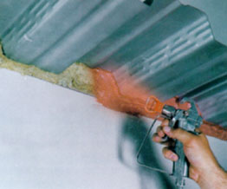
Fire-Resistant Joint Systems

Slide 14
The Protection of Joints
International Building Code – Section 715 – Joints and Voids
  715.3 Fire-resistance-rated assembly intersections. Joints installed in or between fire-resistance-rated walls, floor or floor/ceiling assemblies and roofs or roof/ceiling assemblies shall be protected by an approved fire-resistant joint system designed to resist the passage of fire for a time period not less than the required fire-resistance rating of the wall, floor or roof in or between which the system is installed.

Slide 15
The Protection of Joints
International Building Code – Chapter 2 – Definitions
  Fire-Resistant Joint System. An assemblage of specific materials or products that are designed, tested, and fire-resistance rated in accordance with either ASTM E1966 or UL 2079 to resist for a prescribed period of time the passage of fire through joints made in or between fire-resistance-rated assemblies. (2021 IBC)

Slide 16
The Protection of Joints
International Building Code – Chapter 2 – Definitions
  Based on the definition of joint and the requirements of Section 715.3, in theory any joint in or between fire-resistance-rated construction created due to building tolerances or designed to allow for building movement requires protection by a fire-resistant joint system.

Slide 17
The Protection of Joints
  In practice, that may not be the case for joints created due to building tolerances. Are fire-resistant joints typically used in the following locations?
    Bottom-of-wall applications
    Inside and outside corners of gypsum board / wood or steel framed walls
    Head-of-wall joints of gypsum board in platform construction

Slide 18
The Protection of Joints
Fire-Resistant Joint Systems are also referred to as:
  Joint Systems
  Construction Joints
  Expansion Joints
  Joint Firestops

Slide 19
Types of Fire-Resistant Joint Systems
Floor-to-Floor
Bottom-of-Wall
Wall-to-Wall
Floor-to-Wall
Head-of-Wall

Slide 20
Methods of Protecting Joint Systems
Elastomeric Systems
  Sealants
  Sprays
Mechanical Systems
  Slotted Tracks
  Offset Tracks
  Draped Blankets

Slide 21
Joint System at
Nominal Joint Width
Elastomeric Caulk or Spray
1”
Roof or Floor Deck
Mineral Wool
Steel Stud
Deep Leg Track
Gypsum Board

Slide 22
Joint System at
Minimum Joint Width
Load
1/2”
Elastomeric Caulk or Spray
Roof or Floor Deck
Mineral Wool
Steel Stud
Deep Leg Track
Gypsum Board

Slide 23
Joint System at
Maximum Joint Width
Elastomeric Caulk or Spray
1-1/2”
Roof or Floor Deck
Mineral Wool
Steel Stud
Deep Leg Track
Load
Gypsum Board

Slide 24
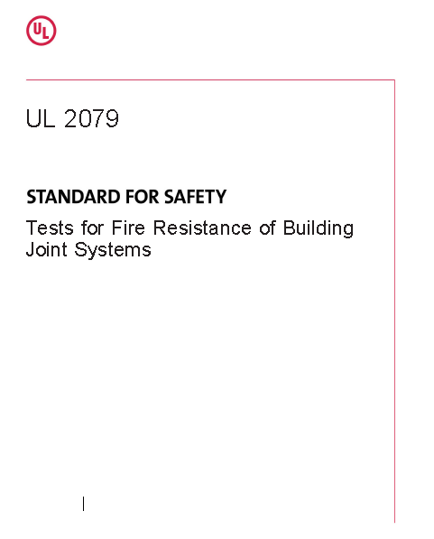
Joint Systems
Test
Method

Slide 25
Standards
UL 2079
ASTM E1966

Slide 26
Ratings
Assembly Rating
L – Leakage (Optional)
W – Water Leakage (Optional, Not Applicable to Head-of-Wall Joint Systems)

Slide 27
Assembly Rating
Passage of Flame
325ºF Individual Point Temperature Rise
250ºF Average Temperature Rise (If Joint Width > 6 in.)
Support Load (Joint in Floor Assemblies, if Load Bearing)
Hose Stream (Joints in Wall Assemblies Only)

Slide 28
L Rating
Air Leakage Rate at Ambient Temperature
Air Leakage Rate at 400ºF

Slide 29
W Rating
Optional program, applicable to incidental water
3 Ft WC Pressure Head / 72 Hr Exposure
Joint subjected to water exposure, followed by standard fire and hose stream tests
Joint systems assigned a W Rating

Slide 30
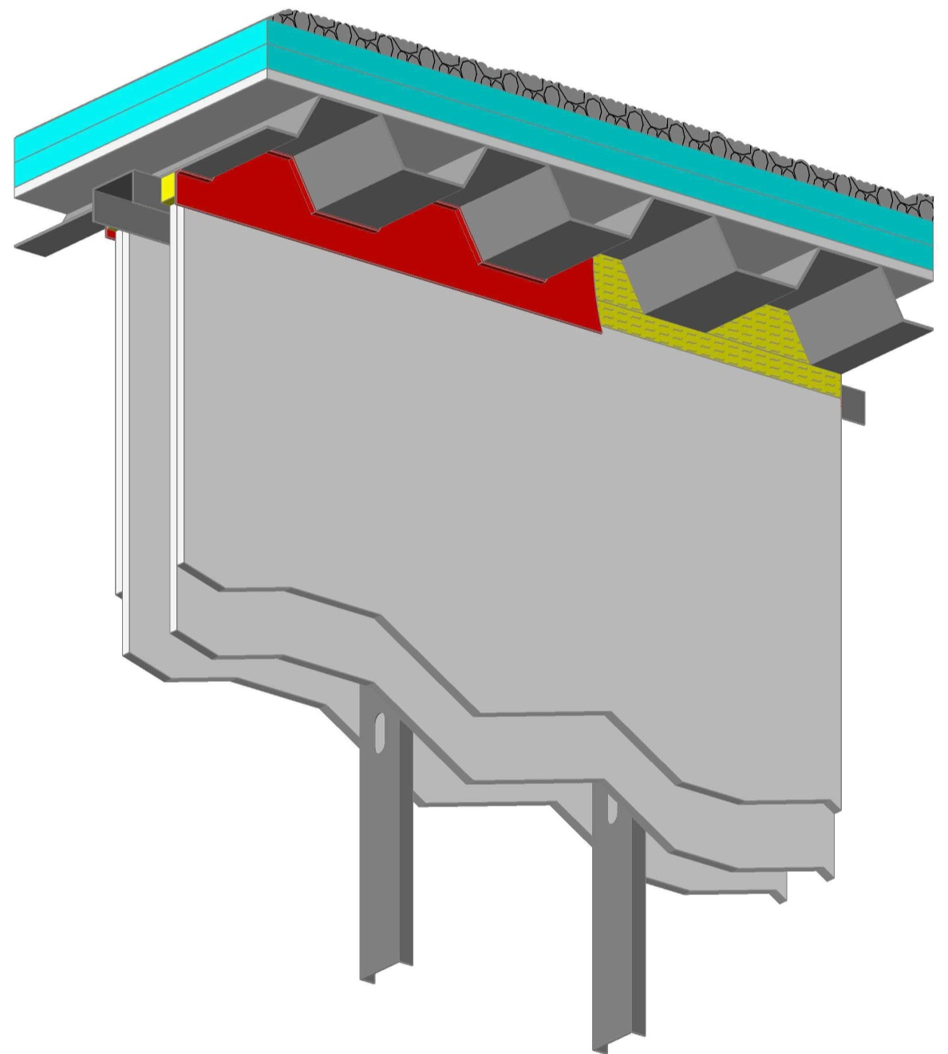
Protection of Voids

Slide 31
The Protection of Voids
International Building Code – Chapter 7 – Fire and Smoke Protection Features
  For the most part, Chapter 7 refers to the breach between rated and non-rated construction, and between non-rated construction as a void.

Slide 32
The Protection of Voids
  Exceptions to this where the breach between rated and non-rated construction, and between non-rated construction is referred to as a joint includes:
    Section 710 – Smoke Partitions
    Section 712 – Vertical Openings
    Section 715 – Joints and Voids, in the list of exceptions of joints not requiring protection in Section 715.3

Slide 33
Format of IBC
707.8 Joints. Joints made in or between fire barriers, and joints made at the intersection of fire barriers with the underside of a fire-resistance-rated floor or roof sheathing, slab or deck above, and with other fire-resistance-rated wall assemblies shall comply with Section 715.
707.9 Voids at intersections. The voids created at the intersection of a fire barrier and a nonfire-resistance-rated roof assembly or a nonfire-resistance-rated exterior wall assembly shall comply with Section 715.
Section 715 then provides the details of how to protect the joint or void.

Slide 34
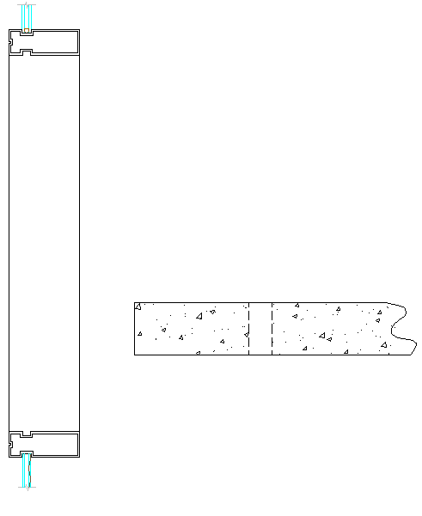


Voids Which Require Protection
Exterior Curtain Wall/Fire-Resistance-Rated Floor Intersection – Referred to as a Perimeter Fire Containment System
Exterior Curtain Wall/Non Fire-Resistance-Rated Floor Assembly Intersection

Slide 35

Voids Which Require Protection
Exterior Curtain Wall/Vertical Fire Barrier Intersection
Fire Barrier/Non Fire-Resistance-Rated Roof Assembly Intersection

Slide 36
Exterior Curtain Wall / Fire-Resistance-Rated Floor Intersection
715.4 Exterior curtain wall/fire-resistance-rated floor intersections. Voids shall protected with an approved Perimeter Fire Containment System
  System tested to ASTM E2307
  F Rating shall be not less than rating of floor
  Exception for cases where vision glass extends to finished floor

Slide 37

Paths of Fire Propagation
1 – Through void between floor and curtain wall
2 – Window to window “leap-frogging”
1
Notes:
How does fire spread at the perimeter of a building?
Fire can:
It is easy to understand that if you have an unprotected void between the floor slab and the exterior curtain wall, that flame and hot gasses will propagate through the joint between the wall and the slab edge.
However, path #2 is not as easily understood. And that is Leapfrog- this is where the fire breaks the glass and the flame and hot gasses escape outside the building and up the face of the curtain wall and breaks through the vision glass on the floor above. Or if the spandrel panel is not properly protected, the fire can break through the vision glass and compromise the wall via the exterior.

Slide 38
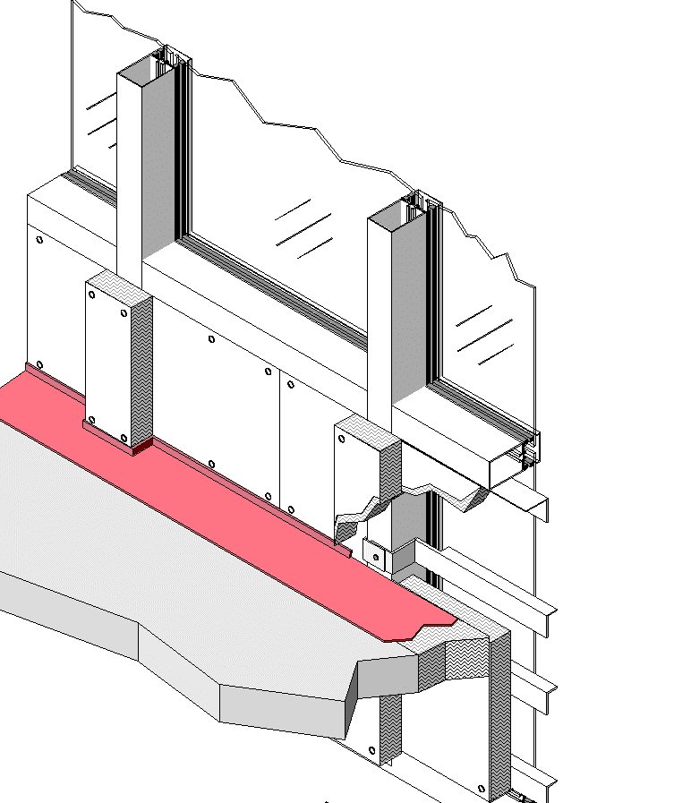
F (Flame) Rating by ASTM E2307
No passage of flames through protected void (i.e. Path 1). Flame passage anywhere else is acceptable.

Slide 39
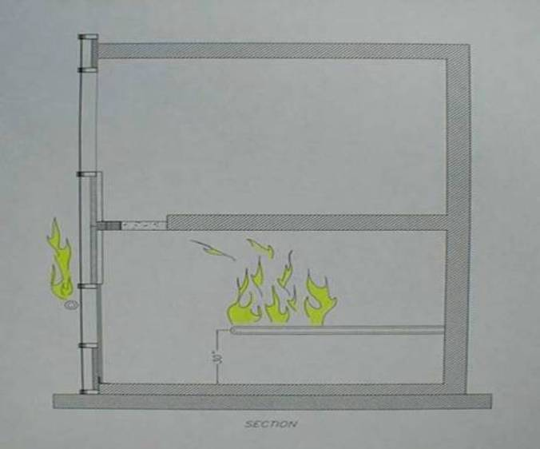
Test Apparatus

Slide 40
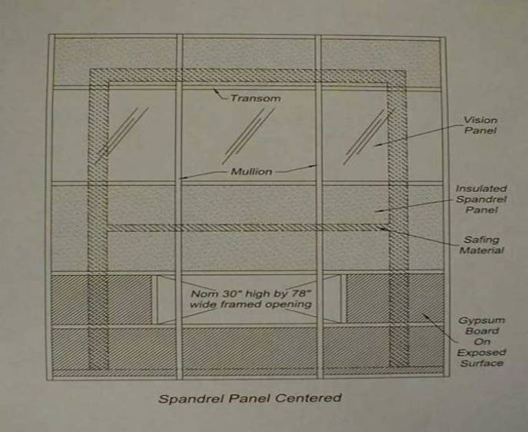
Curtain Wall Orientation

Slide 41
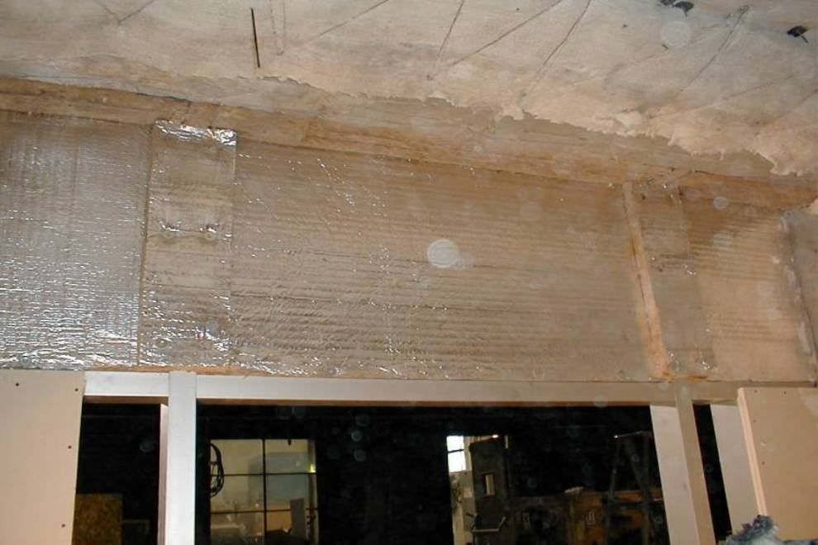
First Floor - Underside of Protected Void

Slide 42
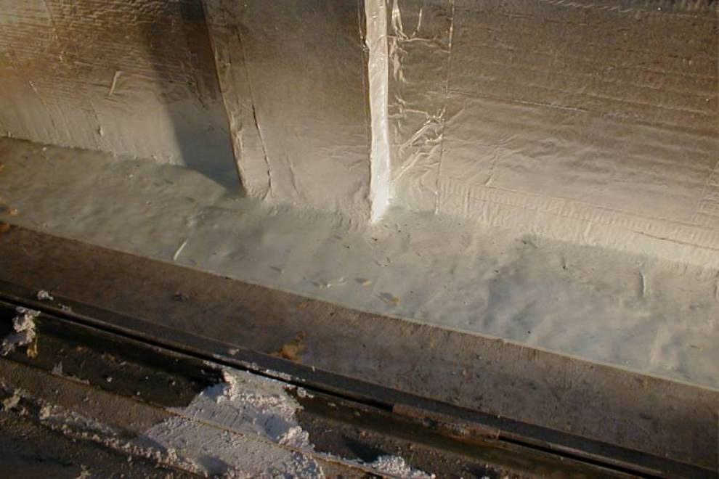
Second Floor – Topside of Protected Void

Slide 43
Conditioning Prior to Fire Test
Movement
Class
Min. No.
of Cycles
Min. Cycling Rate
(Cycles / Minutes)
Class l
(Thermal)
500
1
Class ll
(Wind Sway)
500
10
Class lll
(Seismic)
100
30

Slide 44
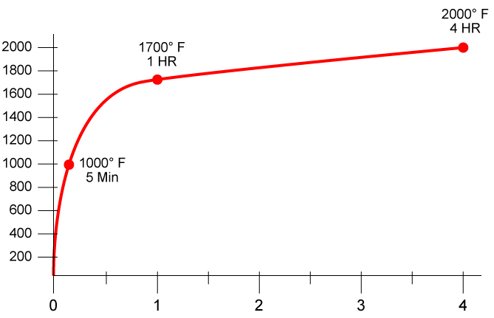
Time-Temperature Curve
Temp
(ºF)
Time (Hr)
Notes:
Fire resistance ratings are determine through the testing of assemblies using gas-fired furnaces. All fire resistance tests are conducted with the furnace temperature controlled in accordance with the standard time-temperature curve. This curve dictates that the temperature will reach 1000°F at 5 min, 1700°F at 1 hr, 1850°F at 2 hr and 2000°F at 4 hr.

Slide 45
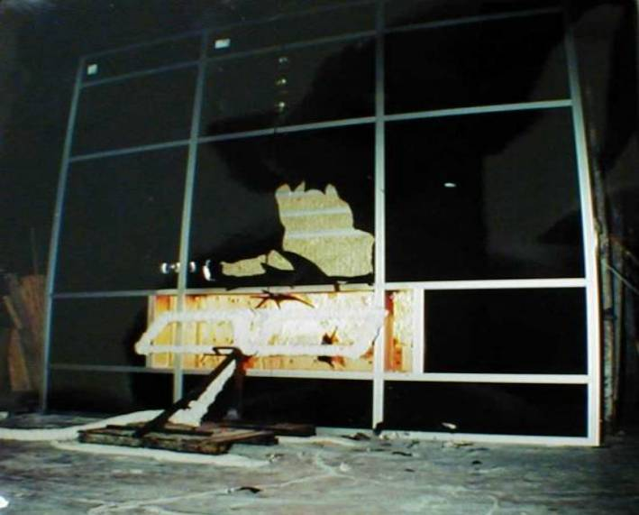
Approximately 2 Minutes

Slide 46
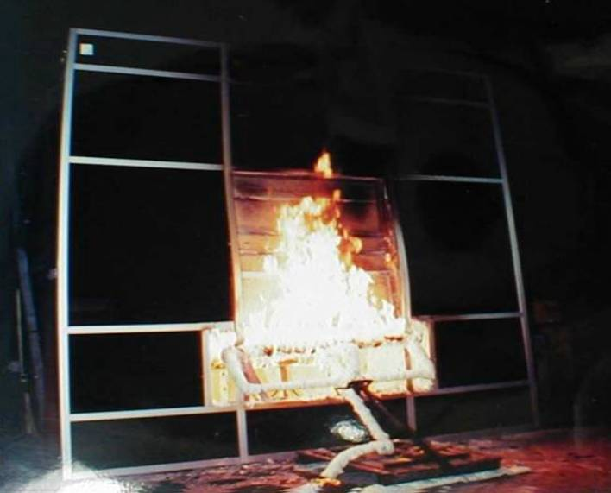
Approximately 120 Minutes

Slide 47
Exterior Curtain Wall/Non Fire-Resistance-Rated Floor Assembly Intersections
Section 715.5 Exterior curtain wall/nonfire-resistance-rated floor assembly intersections. Voids created at the intersection of exterior curtain wall assemblies and nonfire-resistance-rated floor or floor/ceiling assemblies shall be filled with an approved material or system to retard the interior spread of fire and hot gases between stories.

Slide 48
Exterior Curtain Wall/Vertical
Fire Barrier Intersections
Section 715.6 Exterior curtain wall/vertical fire barrier intersections. Voids created at the intersection of nonfire-resistance-rated exterior curtain wall assemblies and vertical fire barriers shall be filled with an approved material or system to retard the interior spread of fire and hot gases.
  Will read “Exterior wall/vertical fire barrier intersections” in 2024 IBC

Slide 49
Fire Barrier/Non Fire-Resistance-Rated Roof Assembly Intersection
707.9 Voids at Intersections. The voids created at the intersection of a fire barrier and a nonfire-resistance-rated roof assembly or a nonfire-resistance-rated exterior wall assembly shall be filled. An approved material or system shall be used to fill the void, and shall be securely installed in or on the intersection for its entire length so as not to dislodge, loosen or otherwise impair its ability to accommodate expected building movements and to retard the passage of fire and hot gases.

Slide 50
Fire Barrier/Non Fire-Resistance-Rated Roof Assembly Intersection
  Requirements for protecting these voids are incorrectly located in Section 707, covering fire barriers. Should be in Sections Section 715.
  2024 IBC has been revised as follows:
    Requirements to protect void between vertical fire barrier and exterior wall “moved” to Section 715.6
    Installation shall be in accordance with Section 715.2

Slide 51
Fire Barrier/Non Fire-Resistance-Rated Roof Assembly Intersection
    Requirements to protect void between fire barrier and non fire-resistance-rated roof assembly moved to Section 715.7 with two options for protection
      Protect with approved material
      Protect with Continuity Head-of-Wall System tested to ASTM E2837, and having an F and T Rating not less than rating of wall
    Installation shall be in accordance with Section 715.2
    Section 707.9 retained as pointer to Section 715

Slide 52
Continuity Head-of-Wall Systems

Slide 53
Background
Continuity Head-of-Wall System
  Higher elevation of head-of-wall location equals
    Higher temperature
    Higher pressure
  A wall is only as good as its weakest link
    Clear need for fire rated doors, glazing, penetration seals, joints
    Likewise, clear need for continuity head-of-wall systems
Notes:
The firestopping of penetrations and joints in the highest parts of a wall are the most critical for preventing fire and smoke spread

Slide 54
Background Cont.
  Continuity provisions of fire barriers requires fire barrier to extend to roof sheathing or deck.
  A void is often required to allow deflection of roof above, or may exist due to construction tolerances
  ASTM E2837: Standard Test Method for Determining the Fire Resistance of Continuity Head-of-Wall Joint Systems Installed Between Rated Wall Assemblies and Nonrated Horizontal Assemblies published in 2011 to address this void.
Notes:
The continuity statement is quite clear: the wall must span from the floor or floor/ceiling below, all the way UP TO the deck above, whether it be a rated or non-rated deck. The continuity statement has never permitted for the fire rated barrier to stop short by either 2 feet, 6 inches, 1 inch or even ¼ inch short of the deck above. The requirement is to span ALL THE WAY to the deck above. In most cases, that won't be possible without using some material other than the wall material in order to close a gap that will likely exist at the top of the wall materials. One frequent reason why such a gap would be purposely created would be to accommodate the inevitable deflection of the floor or roof deck above. All floors and all roofs will deflect some amount due to live loads and dead loads. The anticipated deflection can range from ½ inch all the way to several inches, depending on the span between columns that support that floor or roof above. Thus, a dynamic joint system will be required that can accommodate the specified deflection.
Another reason for a gap at the top of the wall could simply be construction tolerances. It is often practically impossible for the wall material to be installed so that it makes perfect contact all along its length with the floor or roof deck above. For that reason, some gap will inevitably exist, even such a gap was not planned. So once again, does the code permit such a gap? No, the continuity statement would say that the fire resistance if the wall must extend all the way to the deck above. A gap that could allow smoke and/or fire to cross to the other side of the wall because of the gap would defeat the purpose of the fire barrier. Thus, the gap would need to be filled in such a way as to maintain the rating of the wall, and that ensures that the materials stay in the joint during the life of the building, as well as during a fire. The solution can be whatever the code official finds acceptable. However, most code officials look for some type of documentation to show that the proposed joint system will accommodate the anticipated movement, stay in the joint, and prevent fire spread as well as the rest of the wall would.

Slide 55
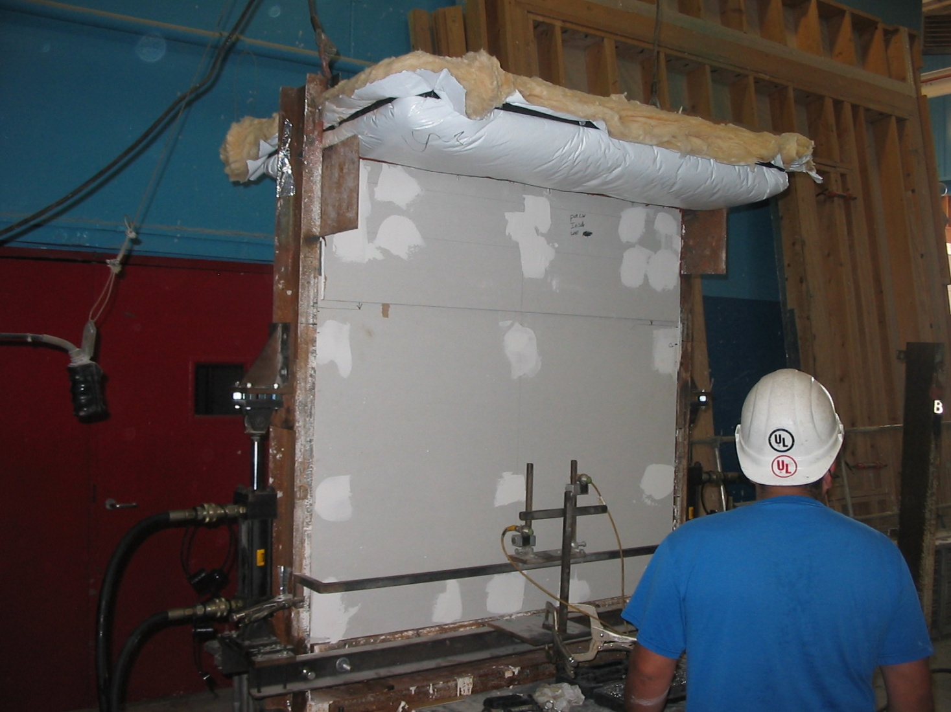
MBMA Tests at UL
General Layout and Conditioning
Photo courtesy of the Metal Building Manufacturers Association
Notes:
This HOW test assembly at UL included a typical 1-hr rated gypsum board wall with steel studs meeting an unrated roof (bare steel deck and purlins with glass fiber blanket). Because the intersection had to allow for relative movement between the wall and roof, a short overlapping and sliding “cripple-wall” detail was attached to the roof. It was designed and tested to provide for up to 2-in movement up and down (compression and extension) . See highlighted red border.
Prior to the fire test, this completed HOW assembly, as built, was subjected to Class II movement cycling of the joint for full 2-in extension and compression.

Slide 56
ASTM E2837 Compared to ASTM E1966
Major differences:
  No thermocouples on wall, roof, floor
  As roof/floor may sag in a “real” fire, test protocol does not rigidly support the roof/floor
E2837-17: Standard Test Method for Determining the Fire Resistance of Continuity Head-of-Wall Joint Systems Installed Between Rated Wall Assemblies and Nonrated Horizontal Assemblies
Notes:
No thermocouples are applied to the wall, as ASTM committee members were adamant that this method should not be measuring the performance of the fire rated wall (that should already be established). In addition, the test method does not have any thermocouples applied to the horizontal assembly (roof or floor), as this test method is designed only for testing top-of-wall joints for rated walls to non-rated horizontal assemblies, and so the fire performance (e.g. temperature) of the horizontal assembly is irrelevant.
Thus, the only thermocouples used are on the joint itself. The only thing being fire tested is whether the joint material or system will prevent the spread of fire and hot gases from one side of the wall to the other for the length of the desired fire resistance rating. This is an important point. The test method is not designed to examine whether the non-rated floor or roof has any specific fire resistance rating. The materials of construction of the non-rated roof or floor is simply used in this test as a variable that could stress the joint in ways that a joint between rated assemblies would not be stressed. To pass this test and obtain a fire resistance rating for the joint, there is no need to modify the non-rated floor or roof in any way.
Since in a real building fire a non-rated roof or floor may sag (deflect downwards due to the heating from the fire), the test protocol does not allow a rigid support for the horizontal assembly, thus allowing it to sag in the fire test if the roof/floor material is so predisposed.
The test method was approved and issued by ASTM in 2011.
As of February 2013, there are 14 design listings for these continuity head-of-wall joints in the UL listing directory.
The UL nomenclature is as follows: CJ stands for Continuity Joint system, the next letter is a D or an S (Dynamic or Static), followed by a numerical sequence number.

Slide 57
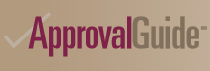
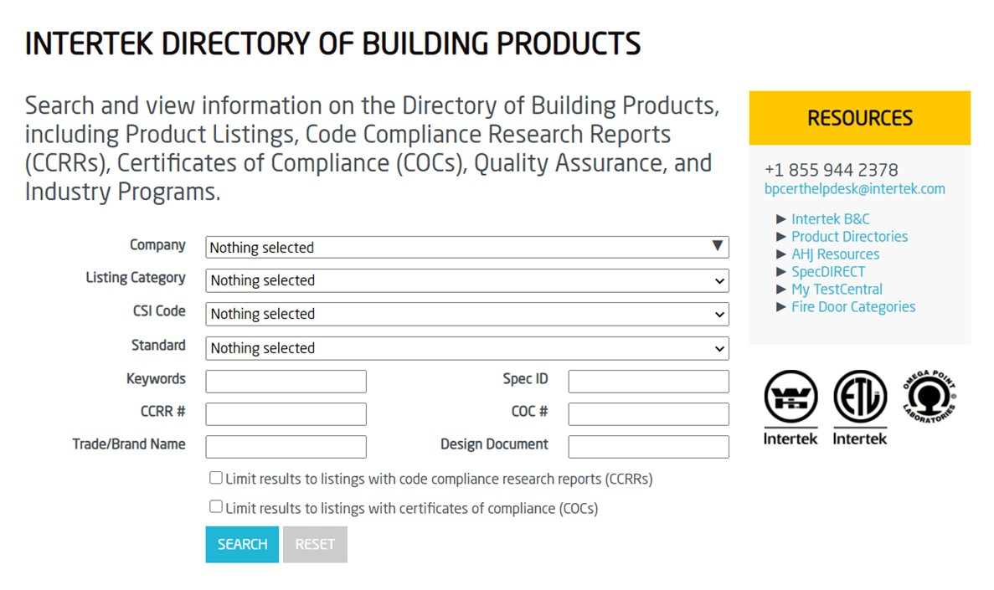

Where Do You Find the Most Current Systems?
Online Directories from the testing laboratories
  FM Approvals
  Intertek
  UL/ULC Product iQ Online Directory
Systems Selection & Analysis…Not as easy as it looks…

Slide 58
Product Categories
XHBN – Joint Systems
  Covers Fire-Resistant Joint Systems including Head-of-Wall Joint Systems
  Includes approximately 2334 individual systems
XHBO – Continuity Head-of-Wall Joint Systems
  Covers Continuity Head-of-Wall Systems
  Includes approximately 25 individual systems

Slide 59
Product Categories Cont.
XHDG – Perimeter Fire-Containment Systems
  Covers Perimeter Fire-Containment Systems
  Includes approximately 225 individual systems

Slide 60
Product Categories Covering Products Used to Construct These Systems
Product Categories
  XHDI – Accessories for Use in Perimeter Fire-Containment Systems
  XHHW – Fill, Void or Cavity Materials
  XHKU – Forming Materials
  XHLI – Light-Gauge Framing
  XHLP – Mechanical Joint Assemblies
  XHLR – Membranes

Slide 61
UL System Approach
Joint Systems (XHBN)
HW-D-0060
What does this mean?
HW - Head-of-Wall Joint System
D - Dynamic
0 - Joint width less than or equal to 2 in.
060 - 60th such system published

Slide 62
UL System Approach
Continuity Head-of-Wall Systems (XHBO)
CJ-D-0015
What does this mean?
CJ - Continuity Head-of-Wall System
D - Dynamic
0 - Joint width less than or equal to 2 in.
015 - 15th such system published

Slide 63
UL System Approach
Perimeter Fire-Containment Systems (XHDG)
CW-D-0015
What does this mean?
CW - Perimeter Fire-Containment System
D - Dynamic
0 - Joint width less than or equal to 2 in.
015 - 15th such system published

Slide 64
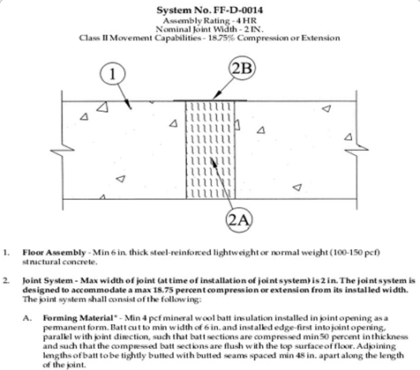
For the Contractor
UL System serve two roles:
Evidence of compliance
2) A set of build-instructions

Slide 65
For the Code Official
UL System serve two roles:
Evidence of compliance
2) Document by which to inspect

Slide 67
Rich Walke, Consultant to the FCIA
Firestop Contractors International Association
4415 W. Harrison St., #540
Hillside, IL 60162
+1-708-202-1108

