Slide 1
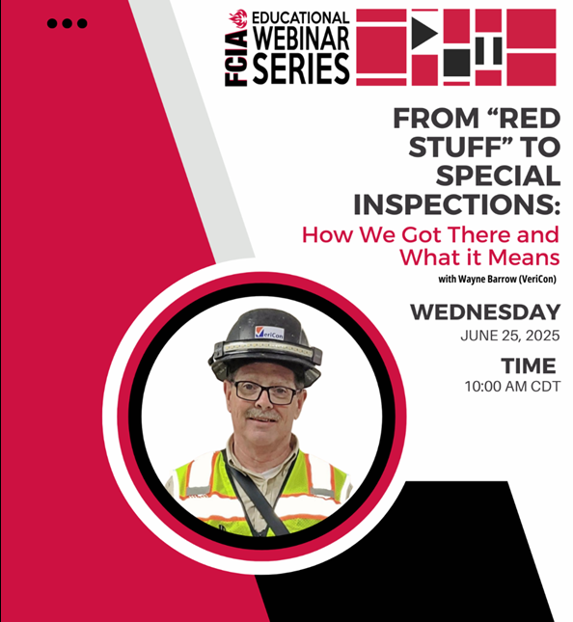
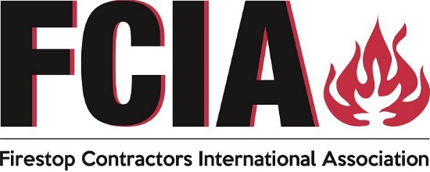
Wayne Barrow, CFPS
VeriCon
FCIA Inspection Committee Member
FREE STUFF –
INFO@FCIA.org

Slide 2
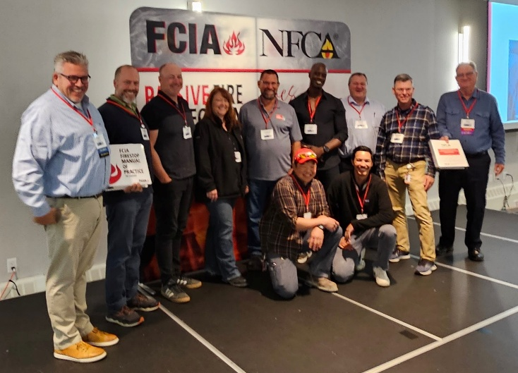
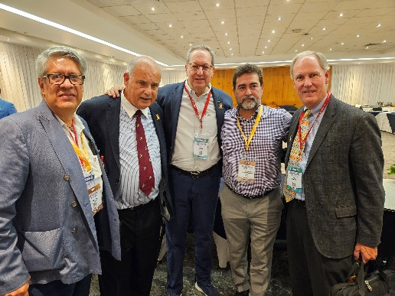
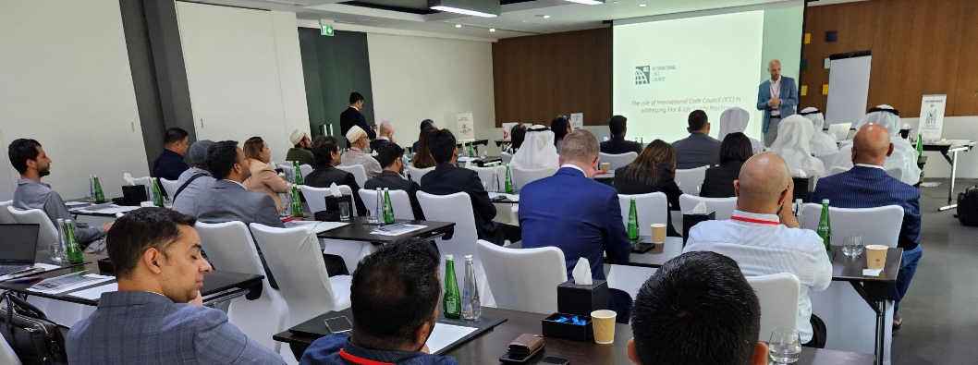
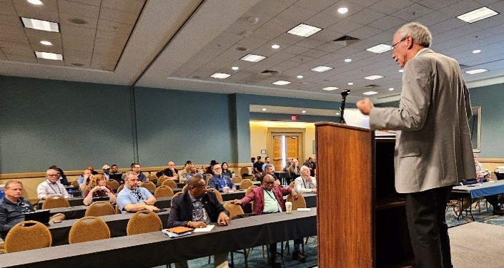


FCIA – Firestop Contractors
International Association
India
United Arab Emirates
Qatar
Canada
Mexico
Saudi Arabia
Australia/New Zealand–Far East

Slide 3
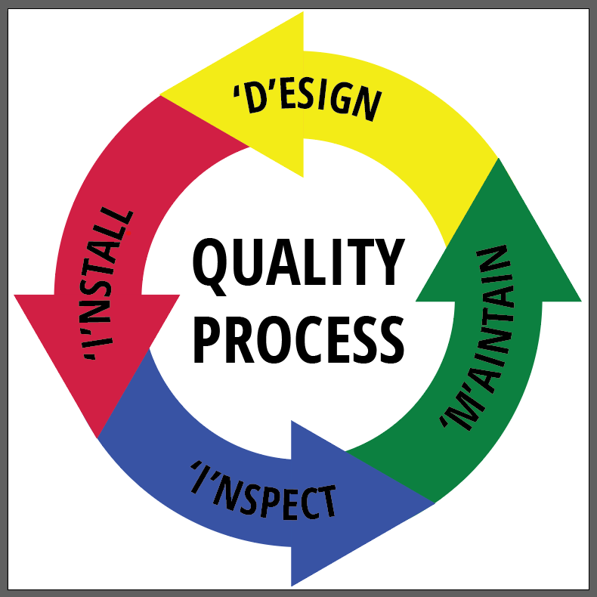
DESIGN
Specs, Code
FCIA’s DIIM™
INSTALLATION
FM 4991/UL QFCP Programs AND Mfr. Education
PFP/BARRIERS MAINTAIN PROTECTION
Fire Codes
INSPECTION
IBC Ch. 17 -NFPA 80 - NFPA 1
Notes:
The DIIM covers a lot.
D is D-Design…code requirements, specifications, systems created by the manufacturers and selection by barrier management survey and installation contractors.
I is I-Installation – in new construction and in existing buildings, organizations qualified through management system programs (UL QFCP, FM 4991, etc.) and workers educated by manufacturers, associations.
I is I-Inspection – in new construction, inspection in accordance with ASTM E2171/ASTM E2393 Inspection Standards for firestopping as required by NFPA 1, International Building Code, NPFA 80 for dampers, doors and glazing,.
M is Maintaining Protection – Maintaining fire-resistance as it was installed – so it works when called upon by fire. – in accordance with NFPA 1, NFPA 101, International Fire Code.

Slide 4
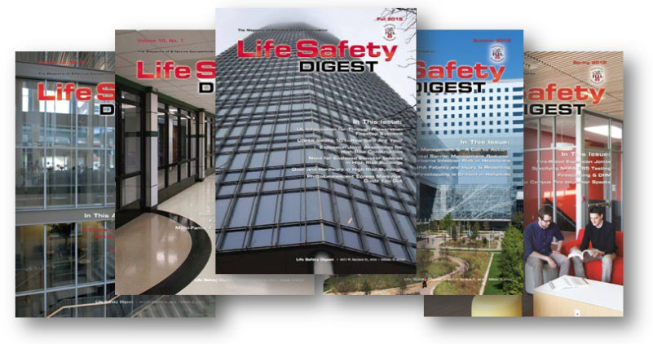
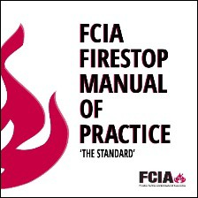
FCIA’s DIIM Worldwide
UL/ULC, FM 4991 Contractor Programs
UL Qualified Fireproofing Contractor Pgm.
ASTM Inspection Standards
IAS AC 291 Inspection Agency Accreditation Program, FM & UL Firestop Exams
Firestop Education Program
  Contractor, Inspection Agency, AHJ, Others
Resources for Specifiers, AHJ’s, Building Owners, Firestop Contractors & Inspection Agencies, Others

Slide 5
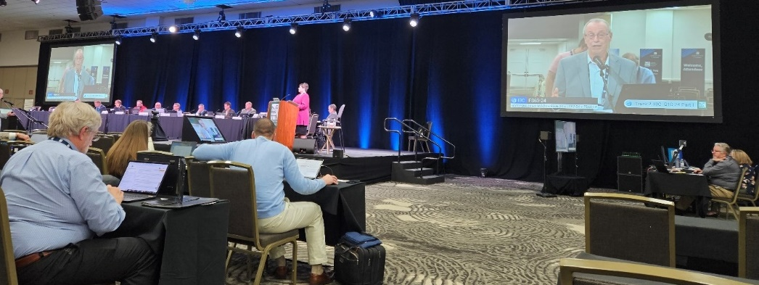

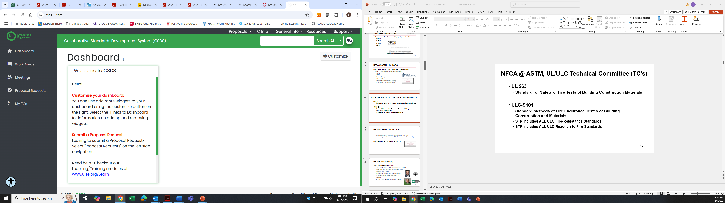
FCIA – Firestop Contractors
International Association
FCIA @ ASTM, ICC, NFPA, UL & ULC STP’s, more…
Advocacy….

Slide 6

FCIA’s DIIM Worldwide
FCIA’s --
  Life Safety Digest
  Firestop Manual of Practice
  Firestop Education Program
• $1000/company/year…UNLIMITED USE
  Education for FM & UL Firestop Exams
  Code Development
  Standards Development
  Much more…

Slide 7

FCIA’s NEWEST PROGRAM –
Education for Firestopping Careers!!
FCIA’s Firestop Education Program (FEP)
  3.5 Hours Level 1 – LAUNCHED
  16.5 Hours Level 2 - LAUNCHED
  4.0 Hours Level 3 – LAUNCHED
  ? Hours Level 0 – Soon!
  3.5 Hours Level 1 Spanish – Soon!
24+ Hours Education…
30++ Hours = Education & Exams –
  Members – Unlimited Subscription
  Non-Members – Visit FCIA.org
  SPECIFIERS, Code Officials, Fire Marshals – FREE Level 1

Slide 8

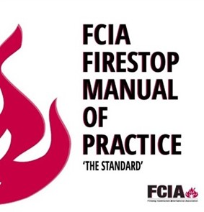
FREE RESOURCES
Info@FCIA.org - REQUEST FREE STUFF
  FREE Life Safety Digest
  FREE MOP, if you Qualify….
  Firestopping DIIM™ Story – www.FCIA.org/About

Slide 9
DESIGN
Specs, Code
FCIA’s DIIM™
INSTALLATION
FM 4991/UL QFCP Programs AND Mfr. Education
PFP/BARRIERS MAINTAIN PROTECTION
Fire Codes
INSPECTION
IBC Ch. 17 -NFPA 80 - NFPA 1
Notes:
The DIIM covers a lot.
D is D-Design…code requirements, specifications, systems created by the manufacturers and selection by barrier management survey and installation contractors.
I is I-Installation – in new construction and in existing buildings, organizations qualified through management system programs (UL QFCP, FM 4991, etc.) and workers educated by manufacturers, associations.
I is I-Inspection – in new construction, inspection in accordance with ASTM E2171/ASTM E2393 Inspection Standards for firestopping as required by NFPA 1, International Building Code, NPFA 80 for dampers, doors and glazing,.
M is Maintaining Protection – Maintaining fire-resistance as it was installed – so it works when called upon by fire. – in accordance with NFPA 1, NFPA 101, International Fire Code.

Slide 10
Wayne Barrow, CFPS
VeriCon
FCIA Inspection Committee Member
FREE STUFF –
INFO@FCIA.org

