Slide 1
Navigating Fire Testing and Classification Requirements For Fire Stopping Systems

Slide 2
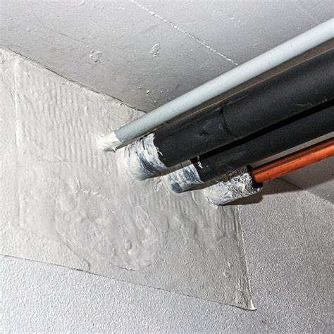
CONTENT
Introduction
Fire Compartmentation & Why it’s important?
Firestopping Systems & Its Benefits.
Firestopping Threads To Fire Safety.
Types Of Penetration Seals
Regulatory Requirements As Per UAE FLS Code
Testing (rules to be considered).
Testing Scope As Per EN 1366-3
DIAP (Field Of Direct Application Of Test Results) Of Various Penetration Seals
10. Classification Of Penetration Seals
(Excerpt from realseal.ca)
Notes:
Basics of fire doors and then we will move to technical discussion, etc.

Slide 3
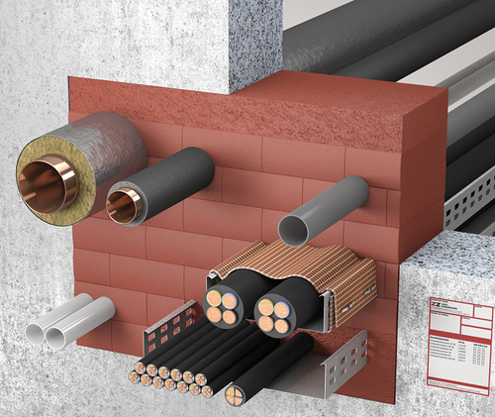
CONTENT
11. Testing Scope As Per EN 1366-4
12. Specific Seal Types As Per EN 1366-4:2021
13. DIAP (Field Of Direct Application Of Test Results) of Linear Joint Seals
14. Classification of Linear joint seals
15. Classification Report Requirement As Per EN 13501-2 (Fire Rating)
16. Comparison of European and American Standard for Firestopping.
17. Comparison of European and American Standard for Joint System.
(Excerpt from z-z.eu.com)

Slide 4
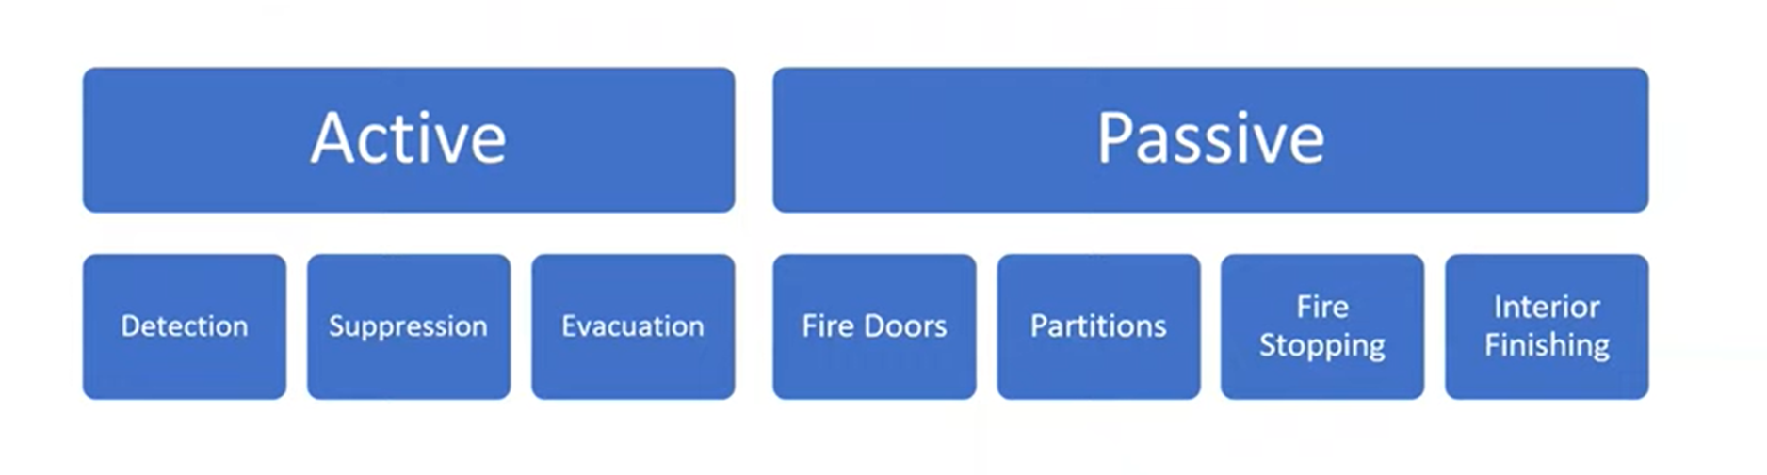
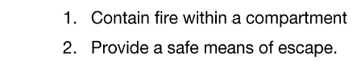
1. Introduction
Purpose
Fire-stopping or Penetration & Linear Joint Sealing is a form of passive fire protection system that maintains the fire-resistance rating of a wall or floor to prevent or impede the spread of fire and smoke from one compartment to another.
These systems are built to withstand fire to manage risk and minimize property damage, providing occupants more time to evacuate safely. They also help contain deadly smoke in one place, which is the main cause of DEATH.
  As the proverb goes, “Prevention is better than cure - it's easier to stop something happening in the first place than to repair the damage after it has happened”.

Slide 5
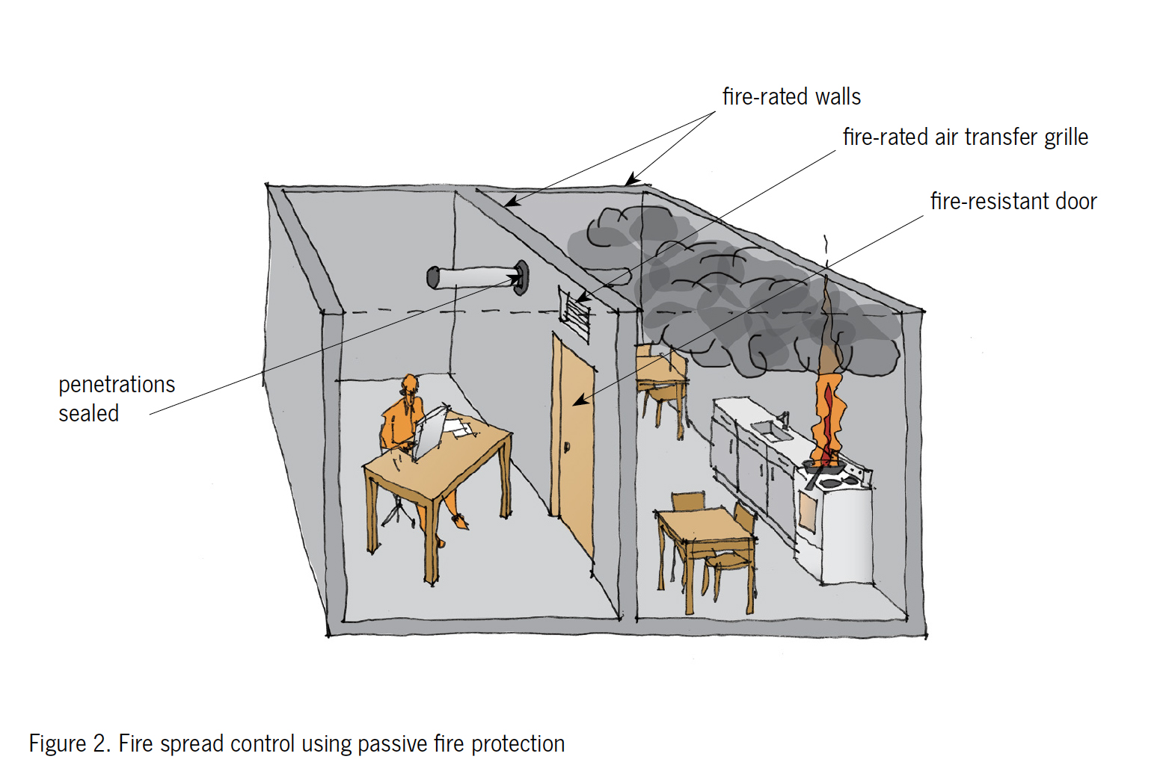
2. Fire Compartmentation & Why It's Important?
Fire compartmentation divides a building into smaller subsections using fire-resistant construction materials. Its goal is to slow down and contain the spread of fire and smoke. Fire compartmentation is a form of passive fire protection, meaning the function works without the need for people and machines, unlike fire alarms or a fire extinguisher (active systems).
Examples of passive systems include floor-ceilings and roofs, fire doors, windows, and wall assemblies, fire-resistant coatings, and other fire and smoke control assemblies.
Image from: www.safetyfirst.co.nz
Notes:
Tested and certified systems
Proper installation of passive fire protection systems
Proper maintenance of passive fire protection systems

Slide 6
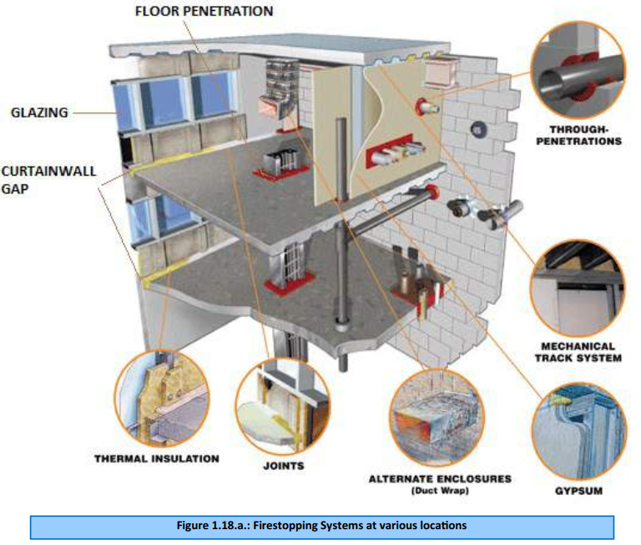
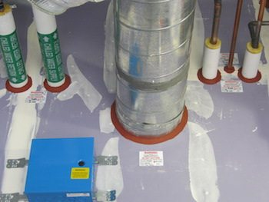
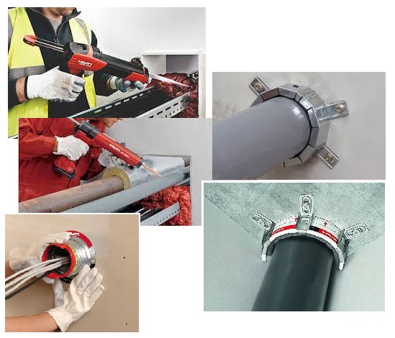

3. Various Firestopping Systems & Its Benefits
Every hole and penetration created reduces fire rating in a fire-barrier wall or floor constructions, fire resisting ability shall be maintained by fire-stopping
Every open construction joint is a threat to fire safety, this shall also be treated with fire-resistive joints (linear joint gap seal)
Proper firestop systems selection = effectiveness
(Excerpt from WEST COAST Firestopping – For Illustration Only)
(Excerpt from HILTI – For Illustration Only)
(Excerpt from the UAE FLSCP 2018)

Slide 7
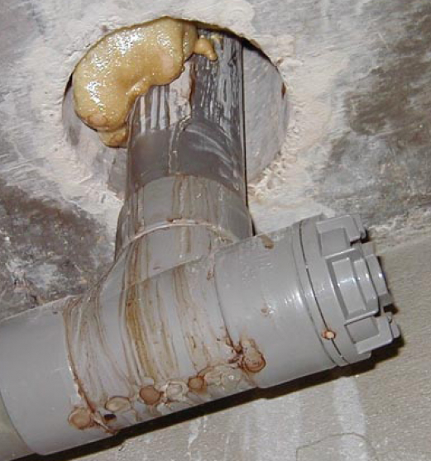
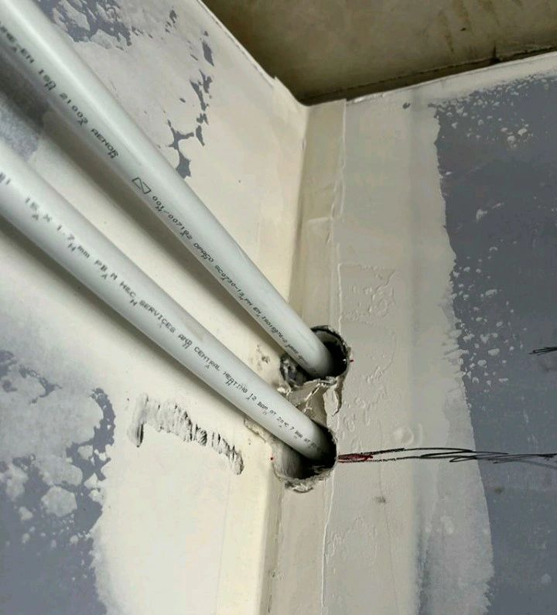
4. Firestopping Threads To Fire Safety
Most crucial thing for firestopping is the way it is installed in site. As tested or as per the procedure outlined by the manufacturer and this job to be done by approved installer (who are certified for this product)
Proper firestop systems selection + Proper Installation = effectiveness
A firestop systems consists of various components e.g. sealant, pipe wraps, foam blocks etc. It is also important that all the material are installed as it was tested or as outlined in the certificate.
There should not be even one component be removed and alternative (similar) materials should not be used in a system which are not certified.
Firestopping products are installed as systems. Only a system carries a rating, not an individual product.
Its also important that all firestop systems should be installed in the right fire barrier wall. Key thing to identity that are
  Thickness of the wall (that was tested)
  Type of the wall or floor like, dry wall, solid wall(e.g. made of AAC, Concrete blocks)
(Excerpt from sharpfibre.com– For Illustration Only)
(Excerpt from Linkedin post– For Illustration Only)

Slide 8
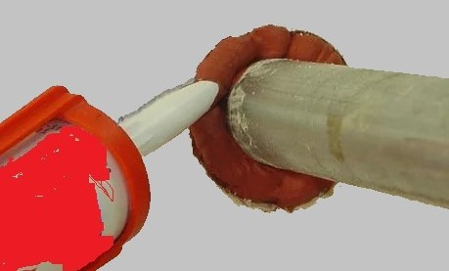
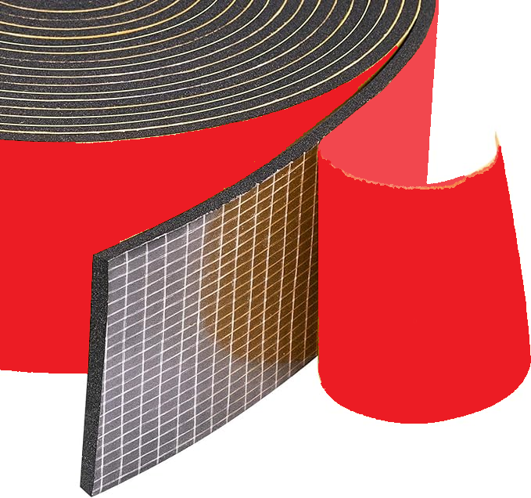

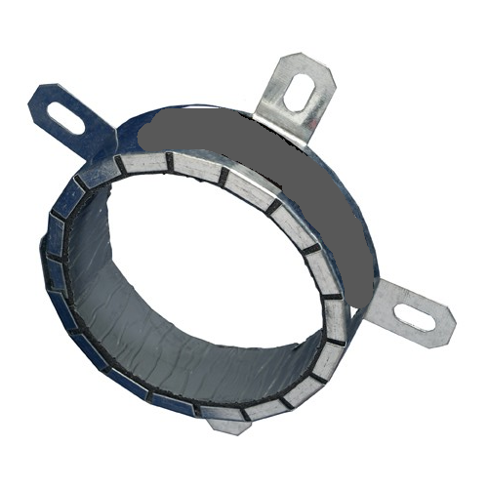
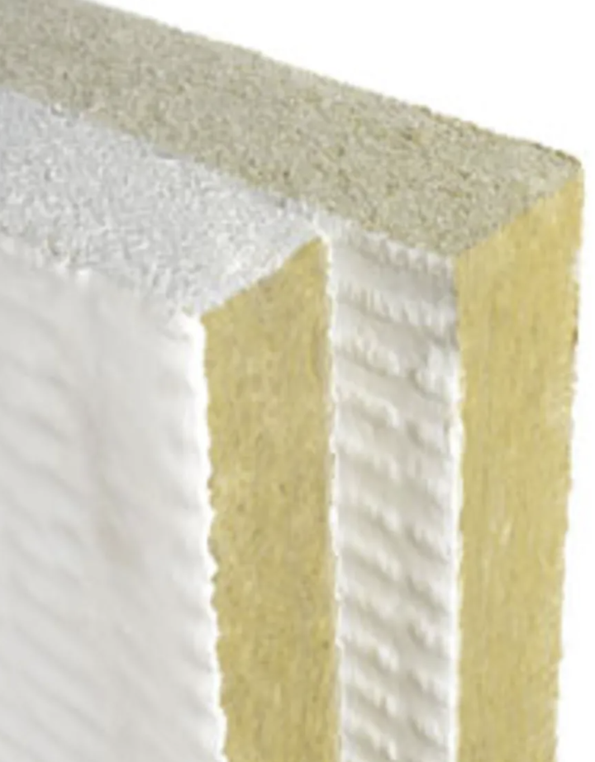
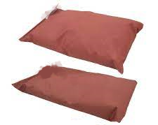
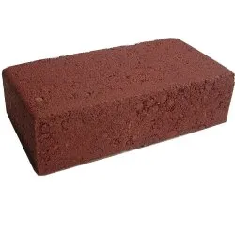
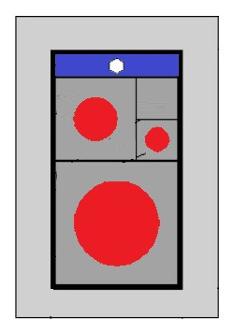
5. Types Of Penetration Seals
Acrylic, Mastic, and
Intumescent Sealant
Ablative Coated Protection
Board or Batt
Foam Block
Gypsum Based Compound
Pipe Wrap Strips
Pipe Collars
Fire Pillow
Modular System
(for cables)
For plastic pipes
For metal pipes, cables
Depending on the type of penetration a properly tested firestop system must be used to seal the gap, since the fire performance of one penetration seal tested with a particular penetration type may differ if used with another penetration type
For plastic pipes, cables
For mixed penetration, bus bar trunking
For cables with or without cable tray
For pipe, cable tray
For cables bundled or single
For mixed penetration, bus bar trunking

Slide 9
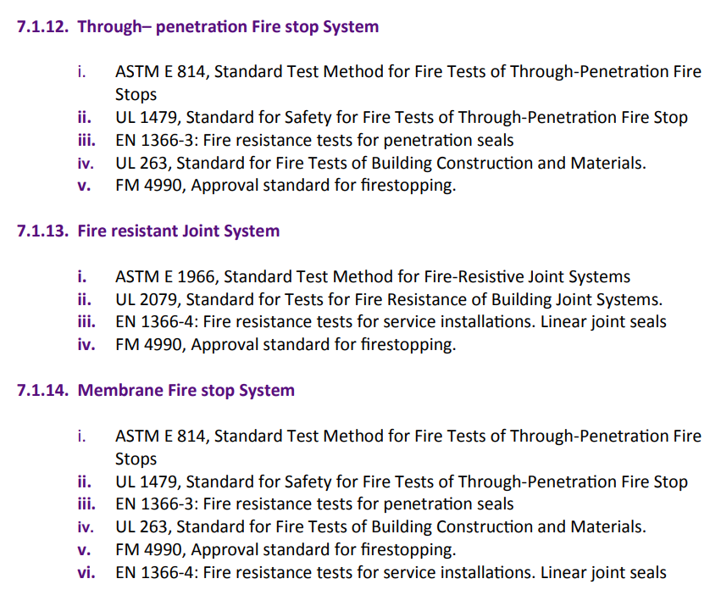
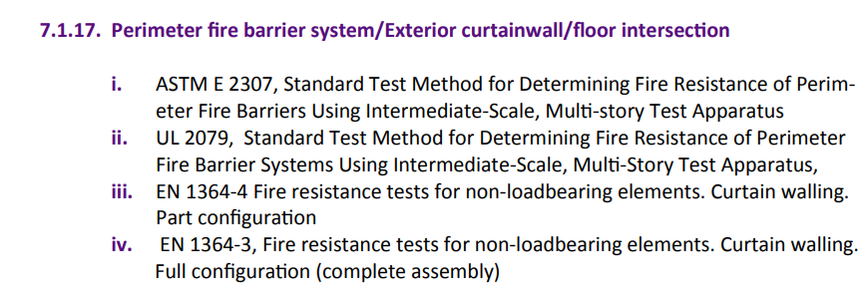
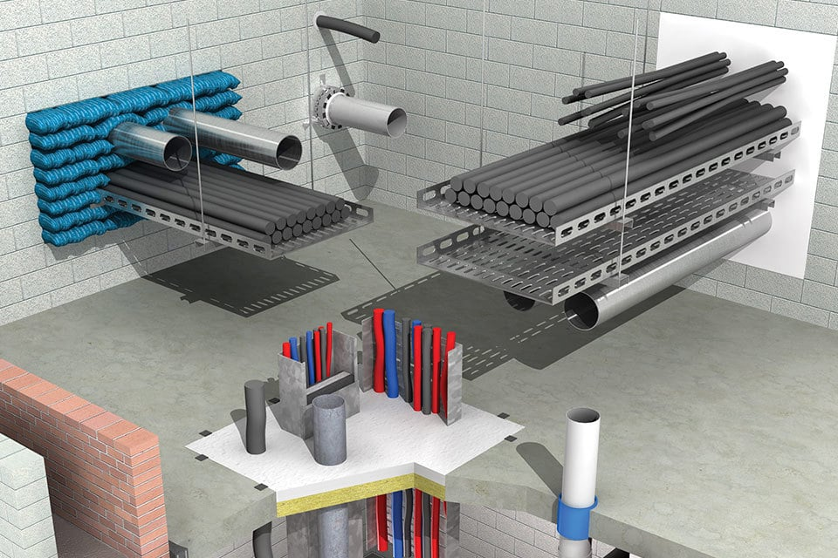
6. Regulatory Requirements (Building Codes) As Per UAE FLS Code
(Excerpt from the UAE FLSCP 2018)
(Excerpt from promat.com)

Slide 10

7. Testing (rules to be considered)
Discussion about the end-use application.
(This should be done between the manufacturer, laboratory, and certification body)

Slide 11
7. Testing (rules to be considered)
Based on the end-use application number of samples from each configuration and design of the firestop system is defined.
Discussion about the end-use application.
(This should be done between the manufacturer, laboratory, and certification body)

Slide 12
7. Testing (rules to be considered)
Sampling of the test specimens by the Certification Body before the test.
Based on the end-use application number of samples from each configuration and design of the firestop system is defined.
Discussion about the end-use application.
(This should be done between the manufacturer, laboratory, and certification body)

Slide 13
7. Testing (rules to be considered)
Fire resistance test on the representative samples.
Sampling of the test specimens by the Certification Body before the test(e.g. ESL certification).
Based on the end-use application number of samples from each configuration and design of the firestop system is defined.
Discussion about the end-use application.
(This should be done between the manufacturer, laboratory, and certification body)

Slide 14
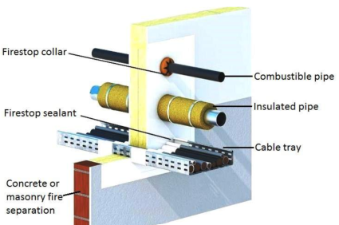
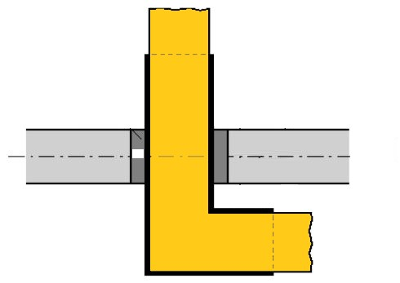
8. Testing Scope As Per EN 1366-3
EN 1366-3 specifies the method of test and criteria for the evaluation of the ability of a penetration seal to maintain the fire resistance of a separating element (fire-rated wall or floor) at the point it has been penetrated by a service or services
Penetration seals (a.k.a. “through penetration fire stopping systems”) used for service penetrations such as:
Cable penetration (with or without cable tray/cable ladder)
Cables within wall passing through Modular system penetration seals
Pipe penetration (metal, plastic pipes)
Conduits and trunkings for cables
Busbar / Busbar Trunking units
Mixed penetration (pipes + cables, other service other than cables &
pipes)
Penetration seals used to seal gaps in fire-rated ventilation & and extraction ducts, shafts, and air ventilation systems are excluded from this EN 1366-3 standard. It can be included using EXAP standard – EN 15882-5
Notes:
However, seals used to seal gaps in walls or floors penetrated by fire-rated ducts, ventilation, and extraction ducts are excluded from this testing standard since they are tested along with the fire-rated duct system.

Slide 15
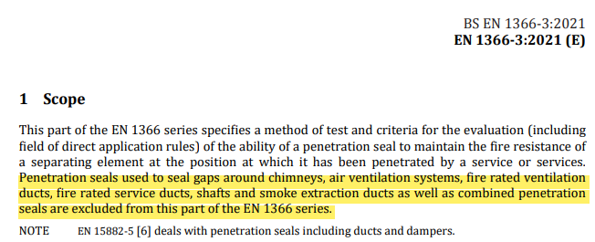
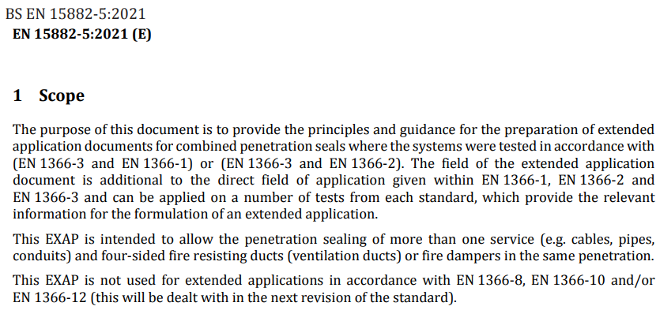
8. Testing Scope As Per EN 1366-3
How any one can include the four sides fire resisting ducts and damper with penetration gap seals in EN 1366-3 test?
Based on the principles and guidelines given in EN 15882-5:2021 that will help to test combined penetration seals and to preparation of extended application documents only for EN 1366-1, EN 1366-2 standards (full scale standards for fire rated duct systems in EN).

Slide 16
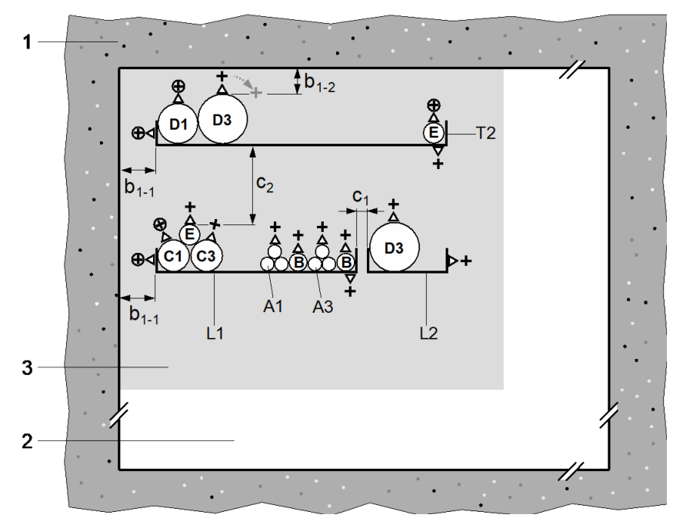
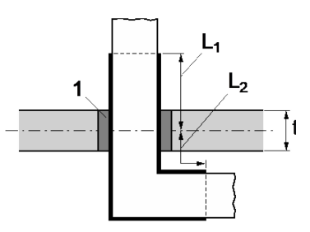
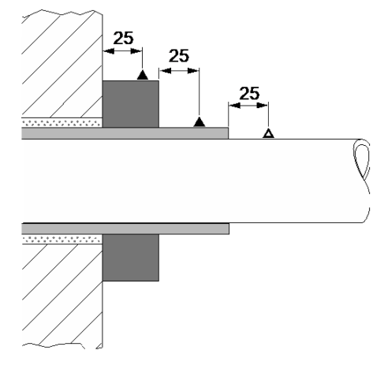
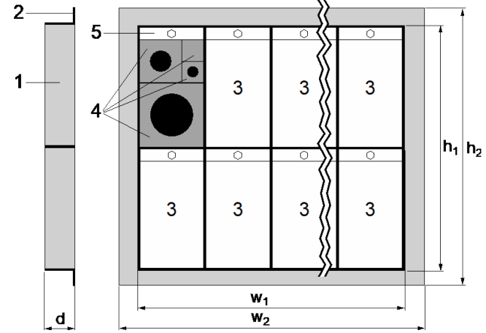
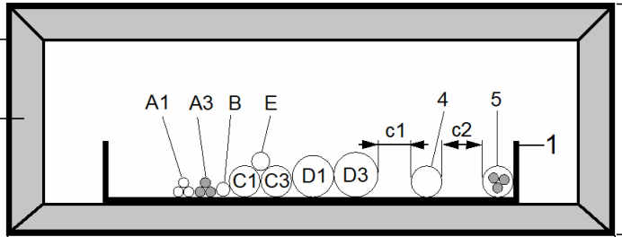
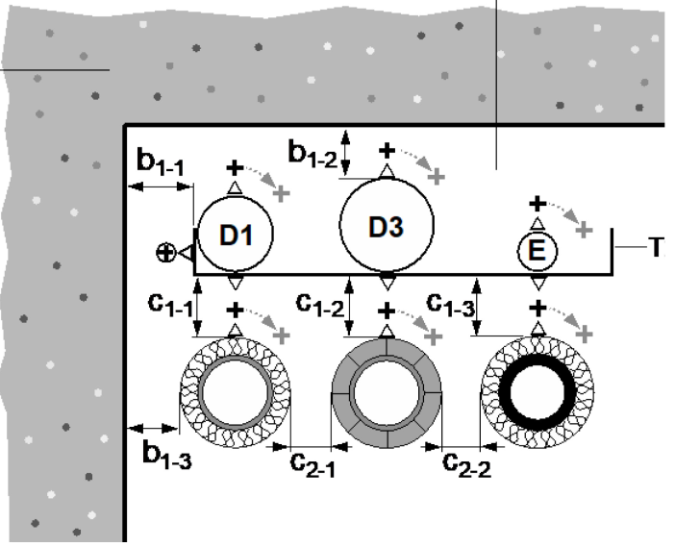
9. DIAP (Field Of Direct Application Of Test Results) Of Various Penetration Seals
From the Annexes of EN 1366-3:2021
Annex A - Configuration and field of direct application for cable penetration seals
Annex B - Special penetration seal systems
(for modular system & steel framed cable boxes)
Annex C - Test configuration and field of direct application for conduits and trunkings for cables
Annex D - Test specimen design and field of direct application for bus bars / bus bar trunking units
Annex E - Test specimen design, test procedure, and field of direct application for pipe penetration seals
Annex F - Test specimen design, test procedure, and field of direct application for mixed penetration seals

Slide 17
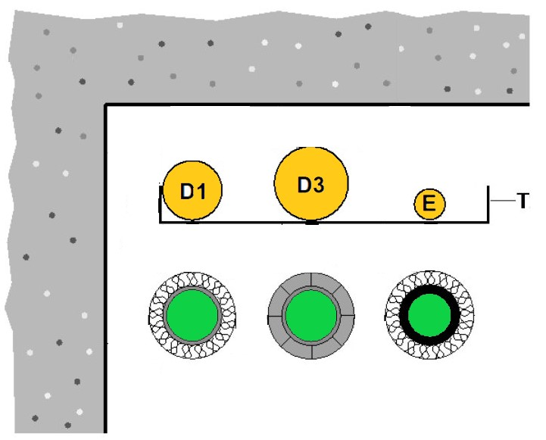
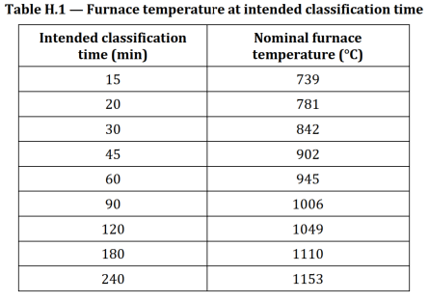
10. Classification Of Penetration Seals
Assessment includes the E = integrity and I = insulation performance of the penetration seal (movement capability is not applicable)
Tested penetration seals can be classified according to EN 13501-2, such as
Classes E 15, E 30, E 45, E 60, E 90, E 120, E 180, E 240 or
Classes EI 15, EI 20, EI 30, EI 45, EI 60, EI 90, EI 120, EI 180, EI 240
In case of pipe penetration, class obtained based on test condition includes letter indication, e.g. EI 30-U/U (for uncapped pipes on both sides)
Tested penetration seal classified to EN 13501-2 withstands furnace temperature according to intended classification time (based on the temperature-time curve in EN 1363-1)
Over a decade, EN 1366-3:2021 has evolved significantly compared to EN 1366-3:2009 edition.

Slide 18
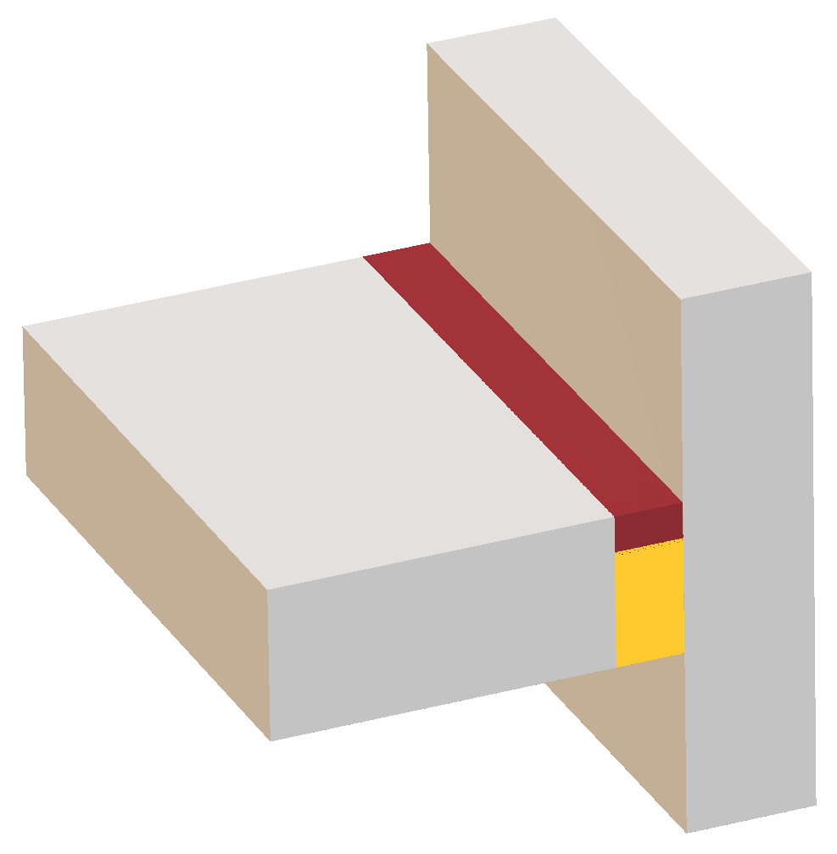

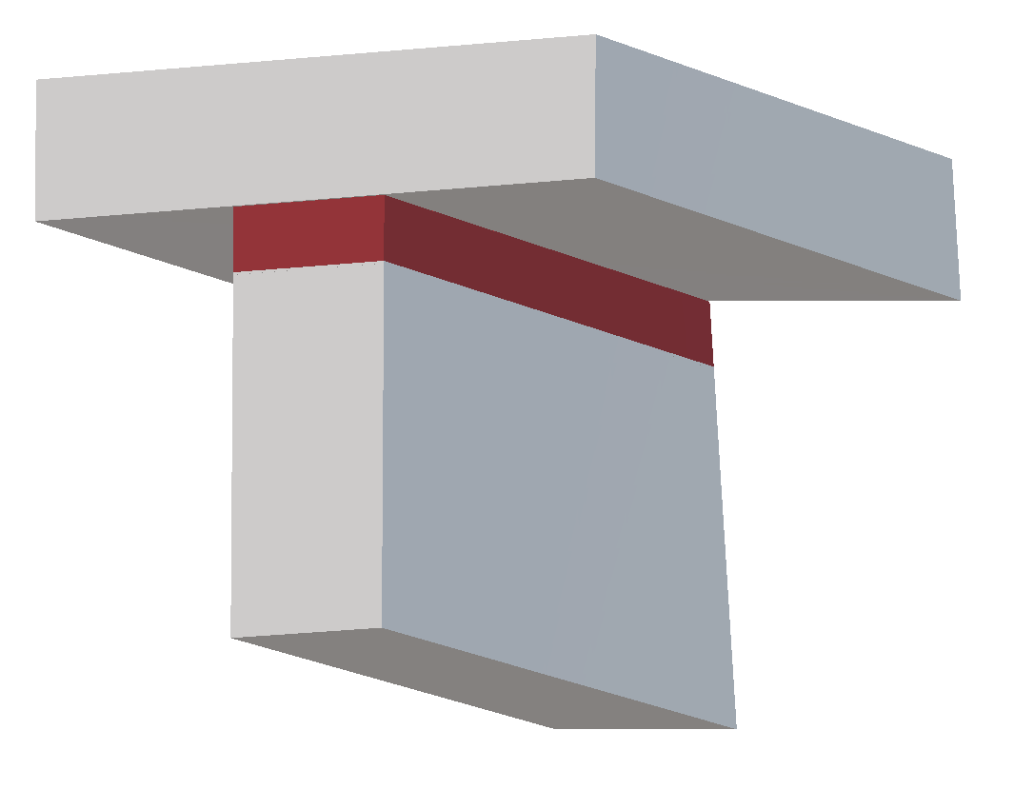

11. Testing Scope As Per EN 1366-4:2021
EN 1366-4 specifies the method for determining the fire resistance of linear joint seals based on their intended use (e.g. floor-to-floor, wall-to-wall, floor-to-wall, or head-of-wall joints) with or without mechanically induced movement
Perimeter seals & vertical linear gap seals of curtain walling are excluded from this standard (perimeter barrier shall be tested to EN 1364-4 and EN 1364-3, and vertical linear gap seal tested to EN 1364-3)
Movement capability tests (following methods in EAD 350141-00-1106)
Floor-to-Wall joint
(NOT A PERIMETER BARRIER IN CURTAIN WALL)
Floor-to-Floor joint
Head-of-Wall joint
Wall-to-Wall joint
Notes:
This standard does not include gap seals in curtain wall systems like perimeter fire barriers and vertical linear gap seals. They are tested according to EN 1364-4 or EN 1364-3 for perimeter barrier and EN 1364-3 for vertical linear gap seal.

Slide 19
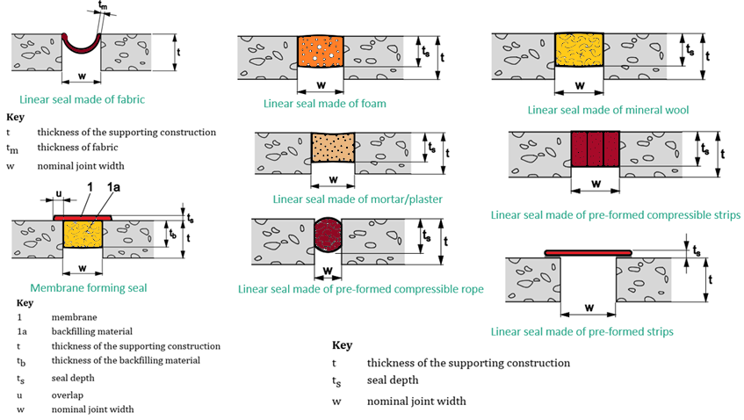
12. Specific Seal Types As Per EN 1366-4:2021

Slide 20
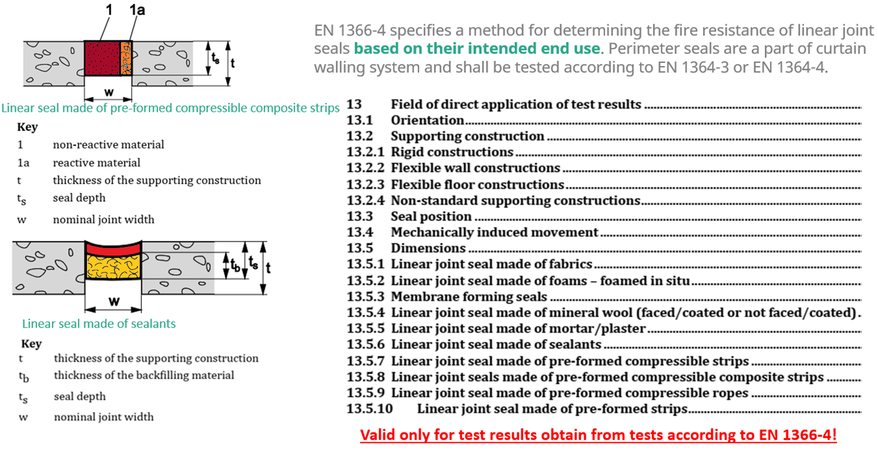
13.DIAP (Field Of Direct Application Of Test Results) Of Linear Joint Seals

Slide 21
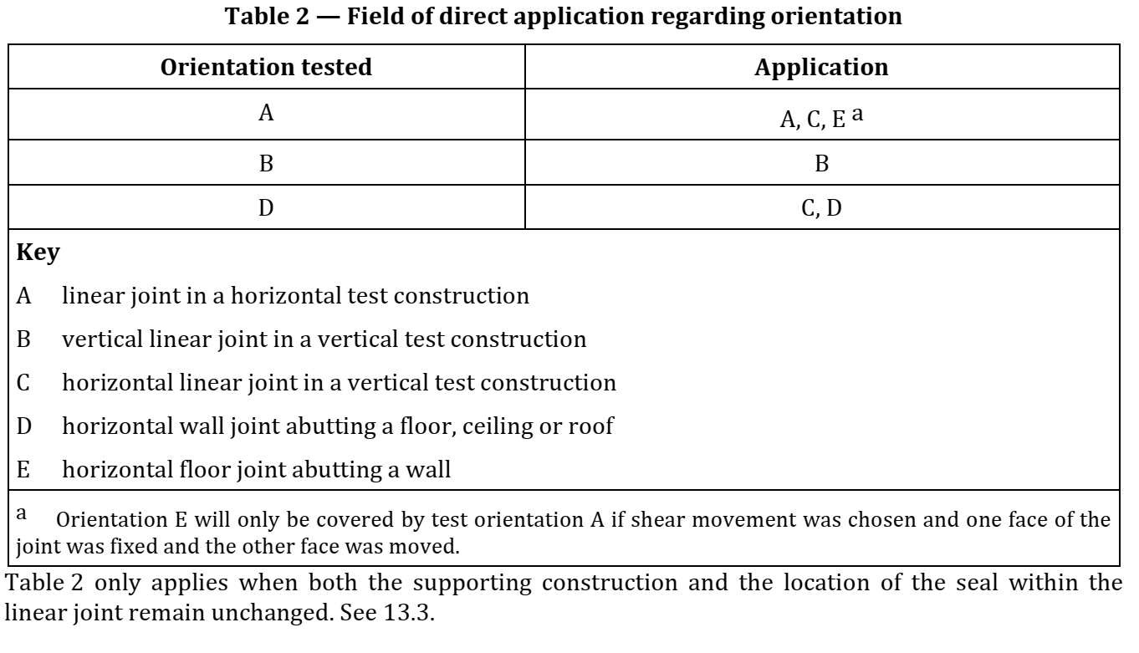
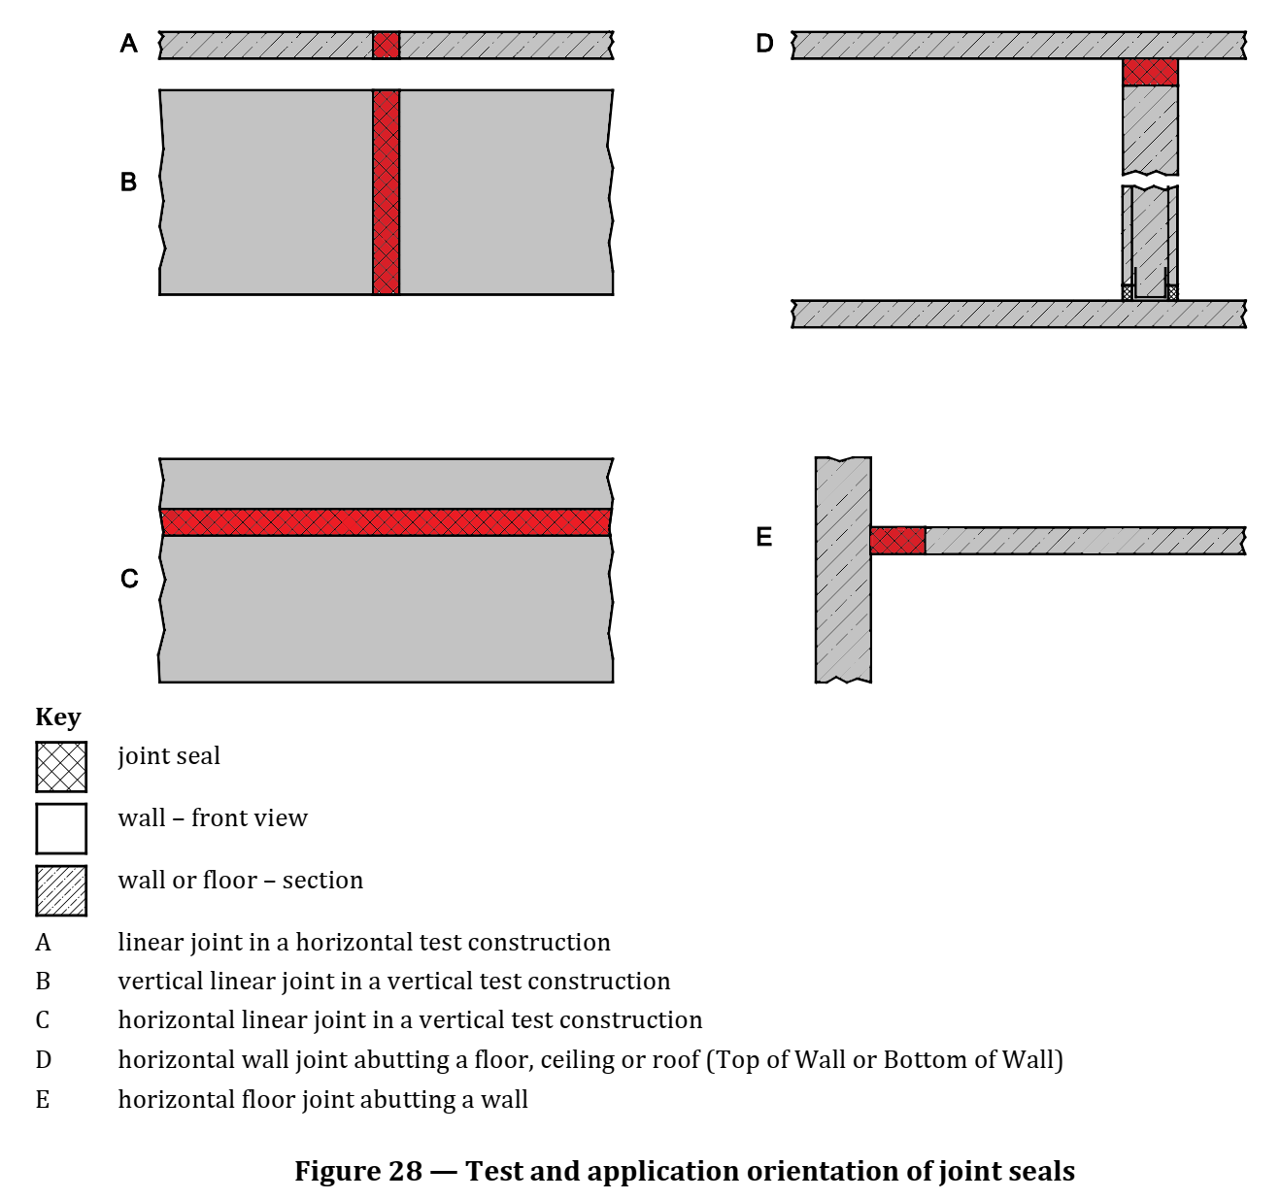
13. DIAP (Field Of Direct Application Of Test Results) Of Linear Joint Seals

Slide 22
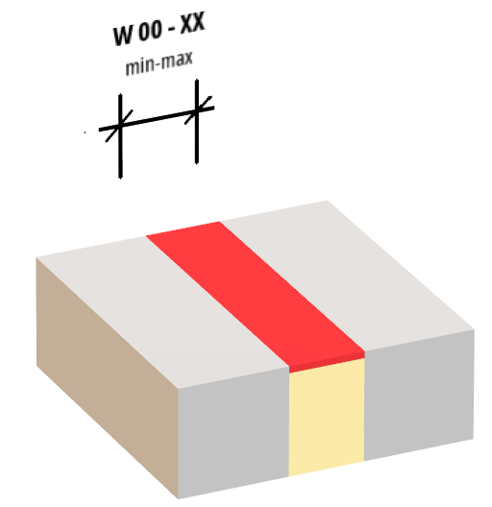
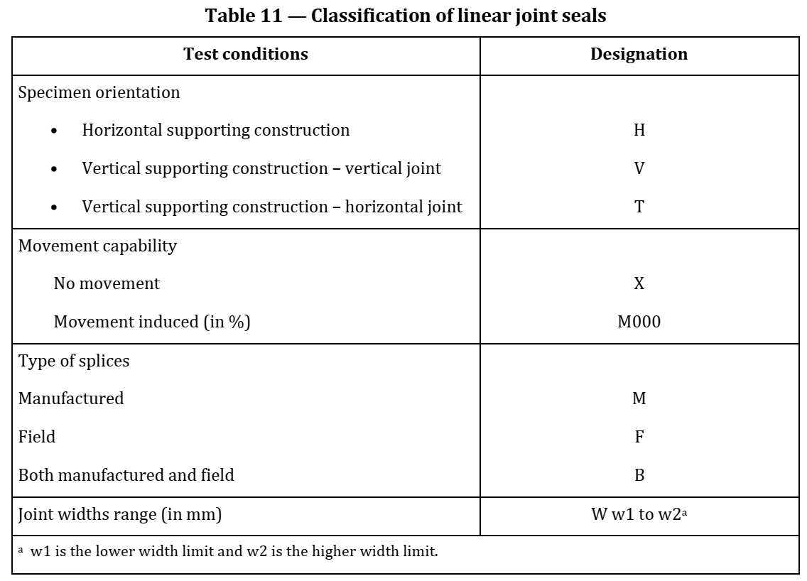
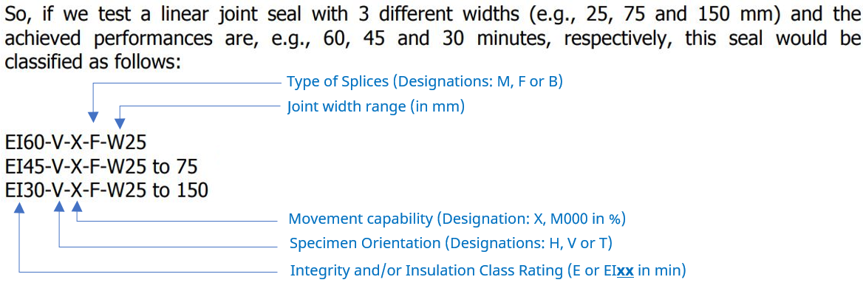
14. Classification Of Linear Joint Seals
Assessment includes the E = integrity and I = insulation performance of the linear joint seal (with or without movement capability)
Tested linear joint seals can be classified according to EN 13501-2, such as
(see important note)
Classes E 15, E 30, E 45, E 60, E 90, E 120, E 180, E 240 or
Classes EI 15, EI 20, EI 30, EI 45, EI 60, EI 90, EI 120, EI 180, EI 240
Important note:
Classification of the linear joint shall include different test conditions (ref. Table 11, EN 13501-2:2016)

Slide 23
15. Classification report requirement as per EN 13501-2 (fire rating)
“Fire Rating” defined as the classification code used to express the classification, is presented as seen in the previous slides.
Fire rating (classification code) is defined by “Classification report”.
The classification report deals with the “Field of direct application of test results,” and where applicable, it also includes an extended application of test results, based on all test reports and EXAP reports of the product.
Why do I need to get the Classification report? Is the test report and certificate being not enough to fulfill the requirements for my product as per EN standards?
Only the classification report will have the designation and the fire rating category for your product such as EI30, EI60 or EI 30 – H – Mlat30 – B – W 30 to W 90 for your product. Because the test report will include only the test results (i.e., only the time / minutes it has achieved).
This requirement comes from the test standard itself to avoid any kind of interpretation of the test results.
You have an advantage to include more than one test report if they are the same product family and it can be classified as per each product’ results in one classification report.

Slide 24
16. Comparison of European and American Test Standards For Firestopping
Description | EN 1366-3 | ASTM E814 | UL 1479
Time-Temperature heating curve | ISO 834-1 curve | ASTM E119 curve | UL Curve (same as ASTM)
Type of furnace TC | Plate type TC wth mineral insulated sheathed thermocuple | Inconel tube type chromel alumel soldered Thermocuple with electrically insulated type
Pressure conditions | Min. +10 Pa pressure at the bottom of each penetration | Min. +2.5 Pa pressure at the bottom of each penetration (min. 2 pressure probes)
Minimum number of furnace TCs | 8 TCs (varies with furnace size-symmetrically dispersed) | Min 5 TCs (symmetrically dispersed) | Min 9 TCs (symmetrically dispersed)
Performance rating | Integrity (E), Insulation (I)criteria only | F rating, T rating (181°C) & Hose stream test | F rating, T rating (180°C)L rating, W rating & Hose stream test
Min length of Specimen | 500mm | 305mm | 279 to 914mm
Min. distance from boundary/ furnace edge | 200mm | 305mm

Slide 25
17. Comparison of European and American Test Standards For Joint system
Description | EN 1366-4 | UL 2079
Time-Temperature heating curve | ISO 834-1 curve | UL Curve (same as ASTM E119)
Type of furnace TC | Plate type TC wth mineral insulated sheathed thermocuple | Inconel tube type chromel alumel soldered Thermocuple with electrically insulated type
Pressure conditions | Min. +15 Pa pressure at the mid height of each seal | Min. +2.5 Pa pressure at the bottom of each penetration (min. 2 pressure probes)
Minimum number of furnace TCs | Min. 4 TCs (symmetrically dispersed) | Min 9 TCs (symmetrically dispersed)
Performance rating | Integrity (E), Insulation (I)criteria only | F rating, T rating (180°C)L rating, W rating & Hose stream test
Min. length of Specimen | Min. 900mm to 2.6mm or 10:1 ratio | Min. 914mm to 3700mm or 10:1 ratio
Min. distance from boundary/ furnace edge | 200mm & 200mm along the longer edge | 305mm from edge of furnace wall

Slide 26
Thank you
Q & A

